Slide 1
MODULE 1: INTRODUCTION TO TRUENAT
Truenat® Tests for the Detection of TB and Rifampicin Resistance Central-Level Training

Slide 2



ACKNOWLEDGEMENTS
These training modules were developed as a collaboration between the United States Agency for International Development (USAID) and its Infectious Disease Detection and Surveillance project (IDDS) and the Stop TB Partnership, as part of the introducing New Tools Project (iNTP). The content is based on the Stop TB/USAID/GLI Practical Guide to Implementation of Truenat™ Tests for the Detection of TB and Rifampicin Resistance, together with content provided by Molbio Diagnostics (Module 3). The material was technically reviewed and endorsed by the Global Laboratory Initiative.
All reasonable precautions have been taken by the authors to verify the information contained in this publication. However, the published material is being distributed without warranty of any kind, either expressed or implied. The responsibility for the interpretation and use of the material lies with the reader.
In no event shall the authors be liable for damages arising from its use. Development of this document was made possible with financial support from the United States Agency for International Development. The views expressed herein are those of the authors and do not necessarily reflect those of the U.S. Agency for International Development or the U.S. Government.

Slide 3
Introduction
This module discusses the challenges of diagnosing TB and the World Health Organization’s recommendations for TB testing.

Slide 4
01.
TB Context
02.
Plenary Session
03.
TB Laboratory Tests
04.
Truenat
Module 1: Introduction to Truenat
Course Outline
Key Challenges in Diagnosing TB
World Health Organization (WHO) Recommendations
Placement in diagnostic networks
Accuracy

Slide 5
Learning Objectives
By the end of this module, participants should be able to:
Describe the global and country-specific context of TB
List the different laboratory tests used to diagnose TB and drug resistance, and WHO’s recommendations for each
Describe the advantages of introducing Truenat within a TB diagnostic network
Compare the diagnostic accuracy of Truenat to other TB laboratory tests

Slide 6
TB CONTEXT

Slide 7
Global TB Situation
Global Context
10 million people fall ill with tuberculosis (TB) every year.
1.5 million people die from TB each year – making it the world’s top infectious killer.
TB is the leading cause of death of people with HIV and a major contributor to antimicrobial resistance
Source: WHO 2021, https://www.who.int/health-topics/tuberculosis

Slide 8
Global TB Situation
To what extent do you think country is meeting these goals?
WHO End-TB Strategy
WHO-recommended rapid TB diagnostics (WRDs) should be available to all persons with signs or symptoms of TB
All bacteriologically confirmed TB patients should receive drug-susceptibility testing (DST) at least for rifampin (RIF)
All patients with RIF-resistant TB should receive DST at least for fluoroquinolones (FQs)

Slide 9
Global TB Situation
WHO Guidelines on DST
Updated WHO guidelines stress the importance of DST prior to treatment, especially for the medicines for which WHO-recommended rapid molecular tests are available.
WHO-recommended rapid molecular tests exist for detection of resistance to which medicines?
Rapid molecular tests are available for testing resistance to:
        RIF
  FQs
  Isoniazid (INH)
  Pyrazinamide (PZA)

Slide 10
Country TB Context
TB Data
Number of cases (TB and DR-TB), TB incidence
Number of deaths
Pediatric TB
Treatment coverage and undiagnosed cases
  Emphasize missing cases
Access to molecular testing
Spatial molecular test localization if possible and available
Notes:
Instructor Note: Complete the information in red based on data from your country.

Slide 11
Country TB Context
National Priorities
National priorities per the TB strategic plan, including scaling up molecular testing
Notes:
Instructor Note: Complete the information in red based on data from your country.

Slide 12
Country TB Context
Overview of the Diagnostic Network
Overview of the diagnostic network
Notes:
Instructor Note: Complete the information in red based on data from your country.

Slide 13
PLENARY SESSION
Challenges with Diagnosing TB in Country

Slide 14
TB LABORATORY TESTS

Slide 15

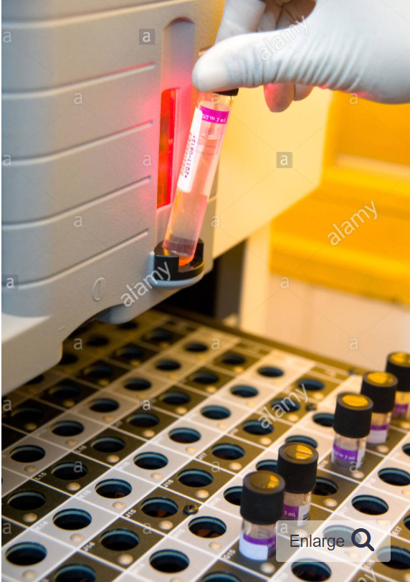
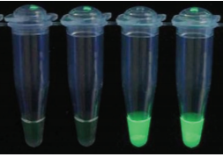
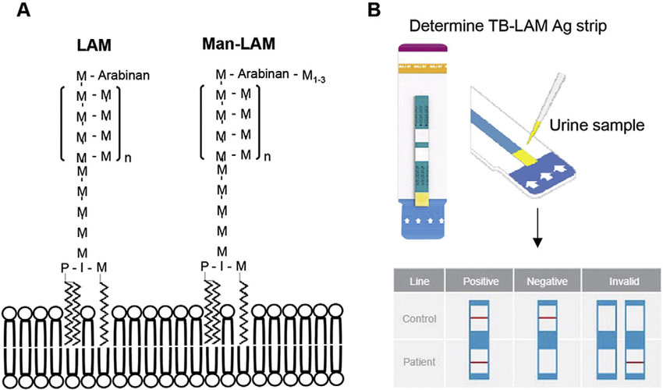
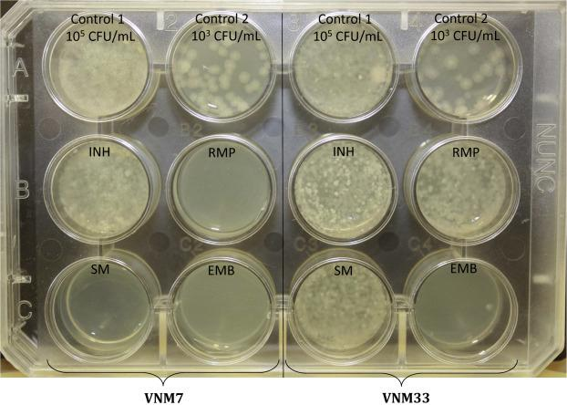
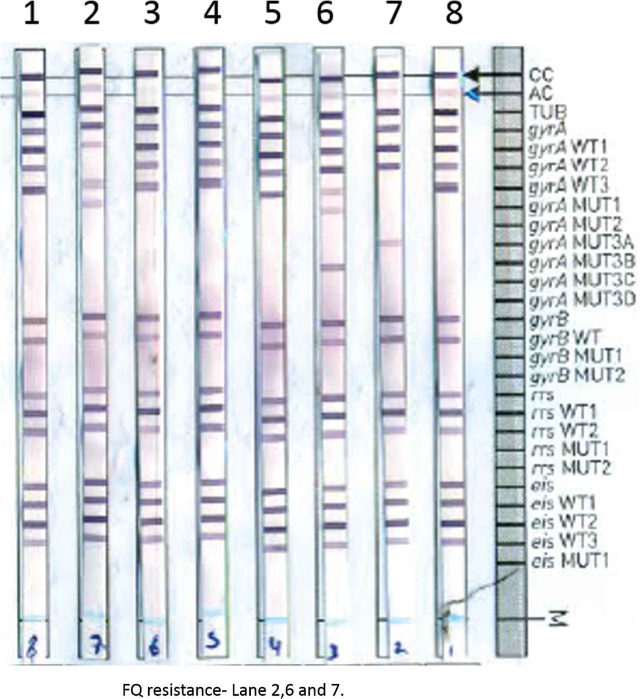
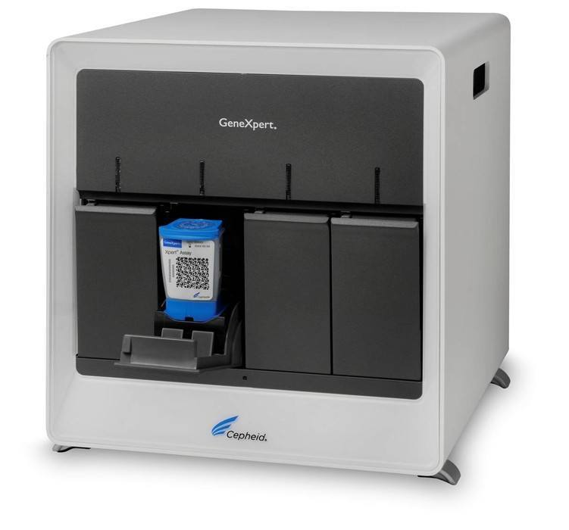
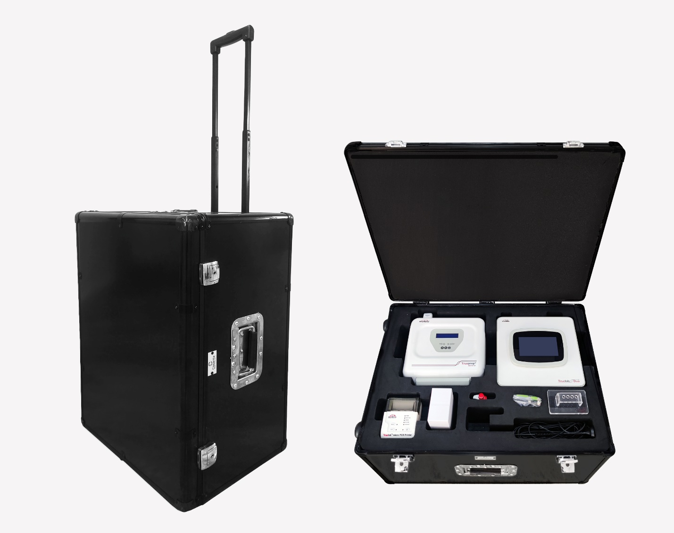
Menu of TB lab tests
MICROSCOPY
CULTURE
TB LOOP-MEDIATED ISOTHERMAL AMPLIFICATION (LAMP)
XPERT MTB/RIF, ULTRA and MTB/XDR
MYCOBACTERIAL LIPOARABINOMANNAN (LAM) ANTIGEN DETECTION
PHENOTYPIC (CULTURE BASED) DRUG SUSCEPTIBILITY TESTING (DST)
LINE PROBE ASSAY (LPA)
TRUENAT

Slide 16
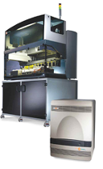
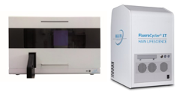
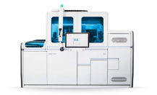

Menu of TB lab tests
Moderate complexity NAATs
MAX MDR-TB
BD MAX systems
FluoroType MTBDR v2.0
cobas MTB and MTB RIF/INH
GeneXtract 96 and FluoroCycler XT
cobas 6800/8800 systems
RealTime MTB and MTB RIF/INH
m2000 RealTIme system
Notes:
In early 2021, the WHO issued an update on the use of NAATs to detect TB and DR-TB and classified them as low complexity (Xpert and Truenat) or moderate complexity (Abbott MTB, Hain Fluorotype MTDR, Roche MTB and BD Max MDR-TB). This classification is based on requirements for infrastructure, equipment and technical skills).

Slide 17
Lab Tests for TB
AFB-Smear Microscopy
Uses
Used as an initial diagnostic test for the detection of AFB in PTB
Monitors response to therapy
Benefits
Can be done safely with low risk level and minimal biosafety precautions
Same day results
Inexpensive and widely available
Limitations
Low sensitivity (50%), which is further reduced in HIV-positive individuals and children
Limited specificity; can detect non-tuberculous mycobacteria(NTMs) and does not detect drug resistance.
Can not detect DRTB
WHO RECOMMENDATION
WHO recommends TB programs transition to replacing microscopy as the initial diagnostic test with molecular WRDs that allow for the detection of MTBC.
For monitoring treatment progress, WHO recommends that in all settings LED fluorescence microscopy should be phased in to replace conventional bright-field microscopy and Ziehl-Neelsen staining.

Slide 18
Lab Tests for TB
Xpert MTB/RIF or Xpert Ultra
Uses
Detects both Mycobacterium tuberculosis complex bacteria (MTBC) and RIF resistance in sputum and EPTB specimens
Benefits
Fast turnaround (<2 hours), high sensitivity, low risk in terms of biosafety
Automated one step process
High sensitivity and specificity
Same machine can be used for multiple tests for diagnosis of HIV, Hepatitis C etc
Limitations
Requires an uninterrupted and stable electrical power supply, yearly calibration of the modules and an ambient temperature of 15-30 °C.
Cannot be used to monitor treatment
Does not detect resistance to anti-TB agents other than RIF
WHO RECOMMENDATION
WHO recommends the use of Xpert MTB/RIF or Ultra as an initial diagnostic test for TB and detection of rifampicin-resistance rather than smear microscopy/culture and phenotypic drug-susceptibility testing.
Notes:
Instructor Notes:
Inform the participants that in many settings and patients groups, RIF resistance is a good proxy for MDR-TB (Uses section).
Inform the participants that under limitations, requires an uninterrupted and stable electrical power supply, yearly calibration of the modules, and an ambient temperature of 15-30 °C (Xpert cartridges and reagents must be stored at 2-28°C)
Inform the participants that under limitations, does not detect anti-TB agents other than RIF (other DST are required for these).

Slide 19
Lab Tests for TB
Culture
Uses
Used as an initial diagnostic for TB as well as to isolate cultures for DST
Monitors MDR-TB treatment
Benefits
High sensitivity and specificity test for the detection of MTBC
Provides an isolate for DST (phenotypic testing)
Can assess treatment progress
Limitations
Requires a high level of biosafety precautions
Requires trained staff
Automated liquid culture is more expensive than solid culture
Solid culture is slow; takes 4–8 weeks to detect MTBC
WHO RECOMMENDATION
WHO recommends the use of liquid culture and rapid species identification within the context of country specific, comprehensive plans for laboratory capacity strengthening and based on a step-wise approach.

Slide 20
Lab Tests for TB
TB-LAMP
Uses
Used as an initial diagnostic for TB
Benefits
Requires minimal infrastructure and has biosafety requirements similar to smear microscopy
Detection of amplified product is based on the turbidity visualized with the naked eye or under ultraviolet light
Requires less than one hour to perform
Limitations
Most suitable for settings with low prevalence of HIV and MDR-TB
Cannot be used to monitor treatment
Does not detect RIF resistance
WHO RECOMMENDATION
WHO suggests using TB-LAMP as a replacement test for sputum smear microscopy for the diagnosis of pulmonary TB.

Slide 21
Lab Tests for TB
LF-LAM Antigen Detection
Uses
Rapid test to detect mycobacterial lipoarabinomannan(LAM) MTBC antigens in urine
Benefits
Requires no equipment
Point of care test
Simple, easy and fast (25 mins)
Easy to collect urine specimen
Allows treatment to be started early
Inexpensive
Limitations
Does not provide any information on drug resistance
Cannot be used to monitor treatment
Low sensitivity
Requires follow up with other diagnostic test
Used in limited patient population
Can not distinguish MTB from other non mycobacteria
WHO RECOMMENDATION
WHO recommends using Alere Determine™ TB LAM Ag for
1) Inpatient settings, to assist in the diagnosis of active TB in HIV-positive adults, adolescents and children with signs and symptoms of TB (pulmonary or extrapulmonary) with advanced HIV disease or who are seriously ill, or with a CD4 cell count of less than 200 cells/mm3 irrespective of signs and symptoms of TB.
2) Outpatient settings, to assist in the diagnosis of active TB in HIV positive adults, adolescents and children who: have signs and symptoms of TB (pulmonary or
extrapulmonary); are seriously ill; or have a CD4 cell count of less than 100 cells/mm3
irrespective of signs and symptoms of TB
Notes:
Instructor Note: Point out website for WHO recommendation in PG https://apps.who.int/iris/bitstream/handle/10665/329479/9789241550604-eng.pdf?sequence=1&isAllowed=y&ua=1

Slide 22
Lab Tests for TB
Phenotypic (culture-based) DST
Uses
Detection of resistance to anti-TB drugs
Benefits
Culture-based, phenotypic DST remains essential for drugs for which there are not yet reliable molecular tests
Phenotypic DST for second-line agents is required to confirm or exclude XDR-TB
Limitations
Requires a high level of biosafety precautions, highly skilled staff and strict quality control
Culture-based phenotypic DST can take weeks to months to generate results
Reliable phenotypic DST methods are not available for all anti-TB drugs
DST remains essential for drugs for which there are not yet reliable molecular tests.
Notes:
Instructor Notes:
For the benefits, inform participants that the culture-based, phenotypic DST remains essential for drugs for which there are not yet reliable molecular tests.
For limitations, inform participants that culture-based phenotypic DST can take weeks to months to generate results, primarily because of the slow growth of mycobacteria.
For limitations, inform participants that reliable phenotypic DST methods are not available for some first- and second-line anti-TB drugs.

Slide 23
Lab Tests for TB
Xpert MTB/XDR
WHO RECOMMENDATION
Uses
Detects resistance to isoniazid and fluoroquinolones, ethionamide and second-line injectable drugs (amikacin, kanamycin and capreomycin)
Benefits
Fast turnaround (<2 hours), high sensitivity, low risk in terms of biosafety
Automated one step process
High sensitivity and specificity
Reflex testing after Xpert MTB RIF resistance result
Testing can be done on unprocessed sputum and concentrated sputum sediments.
Limitations
Requires an uninterrupted and stable electrical power supply, yearly calibration of the modules and an ambient temperature of 15-30 °C.
Only compatible with 10-color GeneXpert modules
Does not detect resistance to new drugs (e.g., Bedaquiline)
Expensive
WHO recommends the use of Xpert MTB/XDR as:
the initial test for the detection of resistance to INH and FQs rather than culture-based phenotypic DST in people with bacteriologically confirmed pulmonary TB
initial test for the detection of ethionamide resistance rather than DNA sequencing of the inhA promoter in people with bacteriologically confirmed PTB and RR
initial test for the detection of the resistance to amikacin rather than culture-based phenotypic DST in people with bacteriologically confirmed PTB and RR
Notes:
Instructor Notes:
Inform the participants that Xpert MTB/XDR tests can only be run on the GeneXpert instruments that use 10-color modules. These are different from the 6-color modules that are traditionally used for Xpert MTB/RIF or Xpert Ultra (Uses section).
Inform the participants that under limitations, requires an uninterrupted and stable electrical power supply, yearly calibration of the modules, and an ambient temperature of 15-30 °C (Xpert cartridges and reagents must be stored at 2-28°C)

Slide 24
Lab Tests for TB
LPA Genotype MTBDRplus/sl
WHO RECOMMENDATION
Uses
Detection of resistance to anti-TB drugs
Benefits
Able to rapidly detect resistance to RIF, INH, FQs and second-line injectables.
Detects Mycobacterium Tuberculosis complex (MTBC) and determines its drug sensitivity to RIF and INH.
Can perform multiple test at once
Fast and accurate results under 48 hrs
Able to provide guidance on treatment decision
Limitations
Requires at least 3 separate rooms to avoid cross-contamination and moderate to high levels of biosafety precautions( biosafety containment level 3)
Cannot be used to monitor treatment
Can not fully replace conventional culture methods
Expensive
Requires well trained staff
FL-LPA is recommended for use on smear-positive sputum specimens and M. tuberculosis isolates as the initial test instead of Phenotypic culture-based DST to detect resistance to RIF and INH.
WHO suggests using SL-LPA as the initial test instead of phenotypic culture-based DST to detect resistance to FQs and AMK directly from patient specimens or cultures.

Slide 25
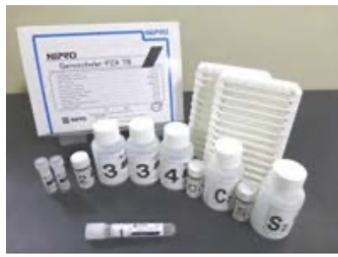
Lab Tests for TB
LPA GenoScholar PZA-TB
Uses
Based on the same principle as Genotype LPA but uses hybridization probes to cover the full pnCA gene to detect resistance to PZA
Benefits
Faster results than phenotypic DST
High sensitivity (>80%) and specificity (>95%) for the detection of PZA resistance
Hybridization can be performed on the TwinCubator instruments used for LPAs
Limitations
Too many probes leads to crowding on the strips so requires careful attention to avoid errors.
High risk of cross-contamination
Requires highly skilled and competent personnel
WHO RECOMMENDATION
WHO recommends the use of high complexity reverse hybridization NAATs in people with bacteriologically confirmed TB for the detection of PZA resistance rather than culture-based phenotypic DST

Slide 26
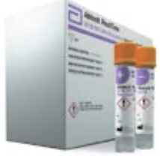
Lab Tests for TB
RealTime MTB RIF/INH
Uses
Real-time pCR for the detection of TB and RIF/INH resistance
Benefits
Automated DNA extraction amplification and detection
High throughput: ~96 tests/run
Multi-disease testing possibilities (HIV, HCV, HBV, HPV, CTNG, SARS-Cov-2)
LOD for TB: 17 CFU/ml
Limitations
Requires highly skilled personnel
Some of the reagents require freezer storage
WHO RECOMMENDATION
WHO recommends that in people with signs and symptoms of pulmonary TB, moderate complexity NAATs be used on respiratory samples for the detection of PTB, Rif resistance and INH resistance rather than culture and phenotypic DST.
Notes:
Extrapolation for use in people with EPTB and testing on non-sputum samples not considered due to limited data on diagnostic accuracy.

Slide 27
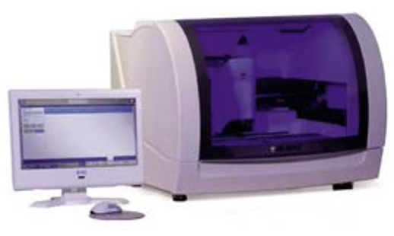
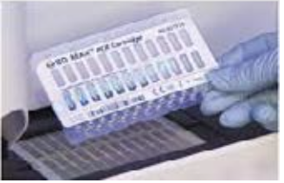
Lab Tests for TB
MAX MDR-TB
Uses
Real-time PCR for the detection of TB and RIF/INH resistance
Benefits
Automated sample preparation and real-time PCR
Untreated sputum samples transported and stored at room temperature can be tested up to 3 days post collection.
Medium throughput ~48 tests / 8-hour workday
Reagents do not require freezer storage
LOD for TB: 0.5 CFU/ml
Limitations
Requires highly skilled personnel
WHO RECOMMENDATION
WHO recommends that in people with signs and symptoms of pulmonary TB, moderate complexity NAATs be used on respiratory samples for the detection of PTB, Rif resistance and INH resistance rather than culture and phenotypic DST.

Slide 28
Lab Tests for TB
FluoroType MTB and MTDR v2.0
Uses
Real-time PCR for the detection of TB and RIF/INH resistance
Benefits
Automated amplification and detection within 3 hours
Both manual and automated options for DNA extraction
Medium throughput ~ 12 samples/run
LOD for TB:: 15 CFU /ml
Limitations
Requires highly skilled personnel
BSL requirements as testing can only be done on decontaminated sputum
WHO RECOMMENDATION
WHO recommends that in people with signs and symptoms of pulmonary TB, moderate complexity NAATs be used on respiratory samples for the detection of PTB, Rif resistance and INH resistance rather than culture and phenotypic DST.

Slide 29
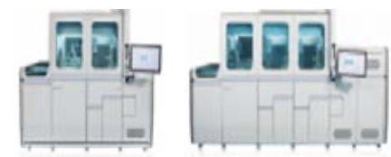
Lab Tests for TB
cobas MTB and MTB-RIF/INH
Uses
Real-time PCR for the detection of TB and RIF/INH resistance
Benefits
Automated DNA extraction, amplification and detection
High throughput ~ 1056 tests/8-hour workday.
Global pricing available through Roche’s Global Access Program
Multi-disease testing capacity (HIV, Hepatitis (A_C), CMV, HSV, Syphilis, immunoassays)
LOD for TB: 7.6 CFU/ml
Limitations
Requires highly skilled personnel
WHO RECOMMENDATION
WHO recommends that in people with signs and symptoms of pulmonary TB, moderate complexity NAATs be used on respiratory samples for the detection of PTB, Rif resistance and INH resistance rather than culture and phenotypic DST.

Slide 30
Lab Tests for TB
Truenat
Uses
First WHO-recommended molecular test for TB and RIF resistance that can be used in peripheral settings with limited infrastructure
Used as an initial diagnostic test for TB
Benefits
Designed to be operated in peripheral laboratories with minimal infrastructure and minimally trained Lab technicians
Battery-powered and uses room temperature stable reagents
Can generate results for TB in one hour and for RIF resistance in one additional hour
Limitations
RIF resistance test is a reflex test
Electricity still required for charging the batteries
More manual steps than the Xpert MTB/RIF test

Slide 31
Lab Tests for TB
Truenat
WHO RECOMMENDATION
In adults and children with signs and symptoms of pulmonary TB, the Truenat MTB or MTB Plus may be used as an initial diagnostic test for TB rather than smear microscopy/culture.
In adults and children with signs and symptoms of pulmonary TB and a Truenat MTB or MTB Plus positive result, Truenat MTB-RIF Dx may be used as an initial test for RIF resistance rather than culture and phenotypic DST.
Notes:
Important to remind that there was not sufficient evidence for EPTB (even if the IFU states that extrapulmonary specimens can be tested)

Slide 32
Truenat Chips
Truenat has three types of chips for three different tests.
MTB
MTB Plus
MTB-RIF Dx
Targets a single copy gene (nrdB) for the detection of M.tb
Targets a single copy gene (nrdZ) and multi-copy gene (IS6110).
A more sensitive test for M.tb detection
Targets the rpoB gene for the detection of RIF resistance

Slide 33
PLACEMENT OF TRUENAT IN DIAGNOSTIC NETWORKS

Slide 34

Lab Tests for TB: Placement in the Network*
Liquid culture
LPA on positive cultures
Microscopy
Solid culture
LPA from smear-positive sputum
Microscopy
Phenotypic DST
TB-LAMP
LF-LAM antigen
Medium complexity NAATs#
Truenat
Point of Care
Where should we place Truenat in this diagram?
Rapid species identification tests
Xpert MTB/RIF
Xpert Ultra
Xpert MTB/XDR
Peripheral
Laboratories
Intermediate (Regional/ District) Laboratories
Nipro Genoscholar PZA-TB
*Tests that can be used in decentralized settings can also be used in centralized settings
#MAX MDR-TB; Fluorotype MTBDR, cobas MTB RIF/INH, Realtime MTB RIF/INH
Central (Reference) Laboratory
Notes:
Note that Xpert MTB/XDR can be placed as low as near-POC settings. Placement should be based on national algorithm and sites with the 10-color modules. Due to infrastructure requirements for most of the moderate complexity NAATs, countries may prioritize placement at national/reference laboratories, however, countries with adequate infrastructure and sufficient sample volume may place these at regional/district laboratories.

Slide 35
Placement of Truenat in Diagnostic Networks
Truenat can be placed at peripheral health centres to replace microscopy as the initial diagnostic test for TB
X-ray may be used as a screening tool for confirmatory testing with Truenat
Specimen referral networks may be needed to allow for further DST

Slide 36
Positioning vs. Xpert or TB-LAMP
Truenat and TB-LAMP can be placed at lower levels than Xpert
Placement at lower levels can increase patient access to rapid molecular testing for TB, decentralize testing for RIF resistance, and reduce need for patient travel
**Truenat is not a replacement for existing Xpert networks
A country can use more than one test for rapid testing

Slide 37
DIAGNOSTIC ACCURACY OF TRUENAT

Slide 38
Diagnostic accuracy relative to culture, in microscopy center settings
 | Sensitivity (all patients) | Sensitivity (SS + patients) | Sensitivity (SS – patients) | Specificity (all patients)
Truenat MTB | 0.73 | 0.91 | 0.37 | 0.98
Truenat MTB Plus | 0.80 | 0.96 | 0.46 | 0.97
Truenat MTB-RIF Dx | 0.84 | 0.88 | 0.67 | 0.95
Foundation for Innovative New Diagnostics, multicenter prospective clinical evaluation study in 19 clinical sites and 7 reference laboratories in 4 countries. (https://erj.ersjournals.com/content/58/5/2100526)

Slide 39
Diagnostic accuracy relative to culture among individuals being evaluated for TB, reference laboratory settings
 | Sensitivity (all patients) | Sensitivity (SS + patients) | Sensitivity (SS – patients) | Specificity (all patients)
Truenat MTB | 0.84 | 0.98 | 0.45 | 0.97
Truenat MTB Plus | 0.87 | 0.99 | 0.55 | 0.95
Xpert MTB/RIF | 0.85 | 0.99 | 0.48 | 0.97
Truenat MTB-RIF Dx | 0.82 | 0.86 | 0.33 | 0.98
Xpert MTB/RIF | 0.84 | 0.89 | 0.33 | 0.98
Foundation for Innovative New Diagnostics, multicenter prospective clinical evaluation study in 19 clinical sites and 7 reference laboratories in 4 countries.

Slide 40
Effect of prior treatment on specificity
 | Specificity – No History of TB Treatment | Specificity – History of TB Treatment
Truenat MTB | 0.97 (0.96-0.98) | 0.92 (0.83-0.96)
Xpert MTB/RIF | 0.97 (0.96-0.98) | 0.90 (0.81-0.95)
Truenat MTB Plus | 0.95 (0.94-0.97) | 0.88(0.78-0.94)
Xpert MTB/RIF | 0.97 (0.96-0.98) | 0.90 (0.80-0.95)
Foundation for Innovative New Diagnostics, multicenter prospective clinical evaluation study in 19 clinical sites and 7 reference laboratories in 4 countries.

Slide 41
Sensitivity and Specificity Trade-Offs
In deciding whether to select Truenat MTB or MTB Plus, countries will need to consider the possible trade-offs between higher or lower sensitivity and higher or lower specificity based on the prevalence of:
  TB
  DR-TB
  TB/HIV
Why might a country with a a high DR-TB burden choose not to use MTB Plus?

Slide 42
High HIV Burden Settings
In a population with a high prevalence of HIV, a more sensitive test (i.e., Truenat MTB Plus) may be the more appropriate test because of its increased sensitivity for the detection of MTBC in smear-negative samples.

Slide 43
Advantages of Truenat
In your opinion, which of these advantages is the most important in your country?
Cost-effectiveness
  Low equipment and test costs
Patient access
  Use of Truenat at primary healthcare level can reduce the need for sample transport for detection of RIF resistance
Time taken for the assay
  MTB detection is completed in 1 hour and the RIF assay is done only as a reflex test
Availability of DNA
  With Truenat, DNA is available for repeat testing and any further investigation and quality control purposes
In – built connectivity allows for use of digital data including rapid reporting of results to clinicians.
Point of care technology(POC), battery operated and portable
Can be used for active case finding strategies remotely in rural areas

Slide 44

Activity: Which Test Should I Use?
Scenario 1:
You are working in a primary care clinic. A 33-year-old woman presents with a low-grade fever and a persistent cough. The woman informs you that she has been coughing for the last two weeks.
Which test(s) should be performed?

Slide 45
Activity: Which Test Should I Use?
Scenario 2:
A patient presents with trouble breathing and coughing that she has experienced for the last week. She tells you that last year she was treated for an illness but she doesn’t know what it was, only that she had to take medicine every day. You do not have access to her health record.
Which test(s) should be performed?

Slide 46
Activity: Which Test Should I Use?
Scenario 3:
A patient enters your clinic with a bad cough that has lasted for two months. Sometimes the cough produces blood. He is also suffering from malaise. You work in a city where there is a high prevalence of HIV.
Which test(s) should be performed?

Slide 47
SUMMARY
Truenat is a promising new TB diagnostic tool
More sensitive and specific than microscopy
Truenat has minimal infrastructure requirements and can be used at POC/near-POC
Results are rapidly available allowing for same-day diagnosis
Truenat can detect RIF resistance within two hours
Can be used as initial resistance test

Slide 48
Knowledge Check – Question 1
1. What are some of the main challenges with diagnosing TB in country?

Slide 49
Knowledge Check – Question 2
2A. , , , , , and are tests that can be used to diagnose TB.
2B. and are tests that can be used to monitor TB treatment.
2C. , , , and are tests that can be used to diagnose RIF resistance.
2D. and are tests that can be used to diagnose other types of drug resistance.

Slide 50
Knowledge Check – Question 3
3. List three advantages of Truenat compared to other tests.
Notes:
Answer:
Cost-effectiveness
Patient access
Time taken for the assay
Availability of DNA for other tests
In-built connectivity

Slide 51
Knowledge Check – Question 4
4. Why is Truenat promising as a new TB diagnostic tool at primary health care settings?
Notes:
Answers:
- More sensitive and specific than microscopy
- Minimal infrastructure requirements and can be used at POC/near-POC
- Results are rapidly available allowing for same-day diagnosis
- can detect RIF resistance within two hours
- Can be used as initial resistance test

Slide 52
THANK YOU

