Slide 1
MODULE 4: ORDER PLANNING AND QUALITY ASSURANCE (QA)
Truenat® Tests for the Detection of TB and Rifampicin Resistance Central-Level Training

Slide 2



ACKNOWLEDGEMENTS
These training modules were developed as a collaboration between the United States Agency for International Development (USAID) and its Infectious Disease Detection and Surveillance project (IDDS) and the Stop TB Partnership, as part of the introducing New Tools Project (iNTP). The content is based on the Stop TB/USAID/GLI Practical Guide to Implementation of Truenat™ Tests for the Detection of TB and Rifampicin Resistance, together with content provided by Molbio Diagnostics (Module 3). The material was technically reviewed and endorsed by the Global Laboratory Initiative.
All reasonable precautions have been taken by the authors to verify the information contained in this publication. However, the published material is being distributed without warranty of any kind, either expressed or implied. The responsibility for the interpretation and use of the material lies with the reader.
In no event shall the authors be liable for damages arising from its use. Development of this document was made possible with financial support from the United States Agency for International Development. The views expressed herein are those of the authors and do not necessarily reflect those of the U.S. Agency for International Development or the U.S. Government.

Slide 3
Introduction
This module provides details on how to forecast and plan supply orders and how to develop and follow quality assurance procedures at test sites.

Slide 4
Learning Objectives
By the end of this module, participants should be able to:
Explain how to forecast for Truenat supplies
List the key elements of good stock management
Identify some quality assurance procedures for Truenat testing

Slide 5
01.
Forecasting and Quantification
02.
Quality Assurance
03.
Monitoring Quality
04.
Summary
Module 4: Order Planning and QA and Control
Course Outline

Slide 6
FORECASTING AND QUANTIFICATION

Slide 7
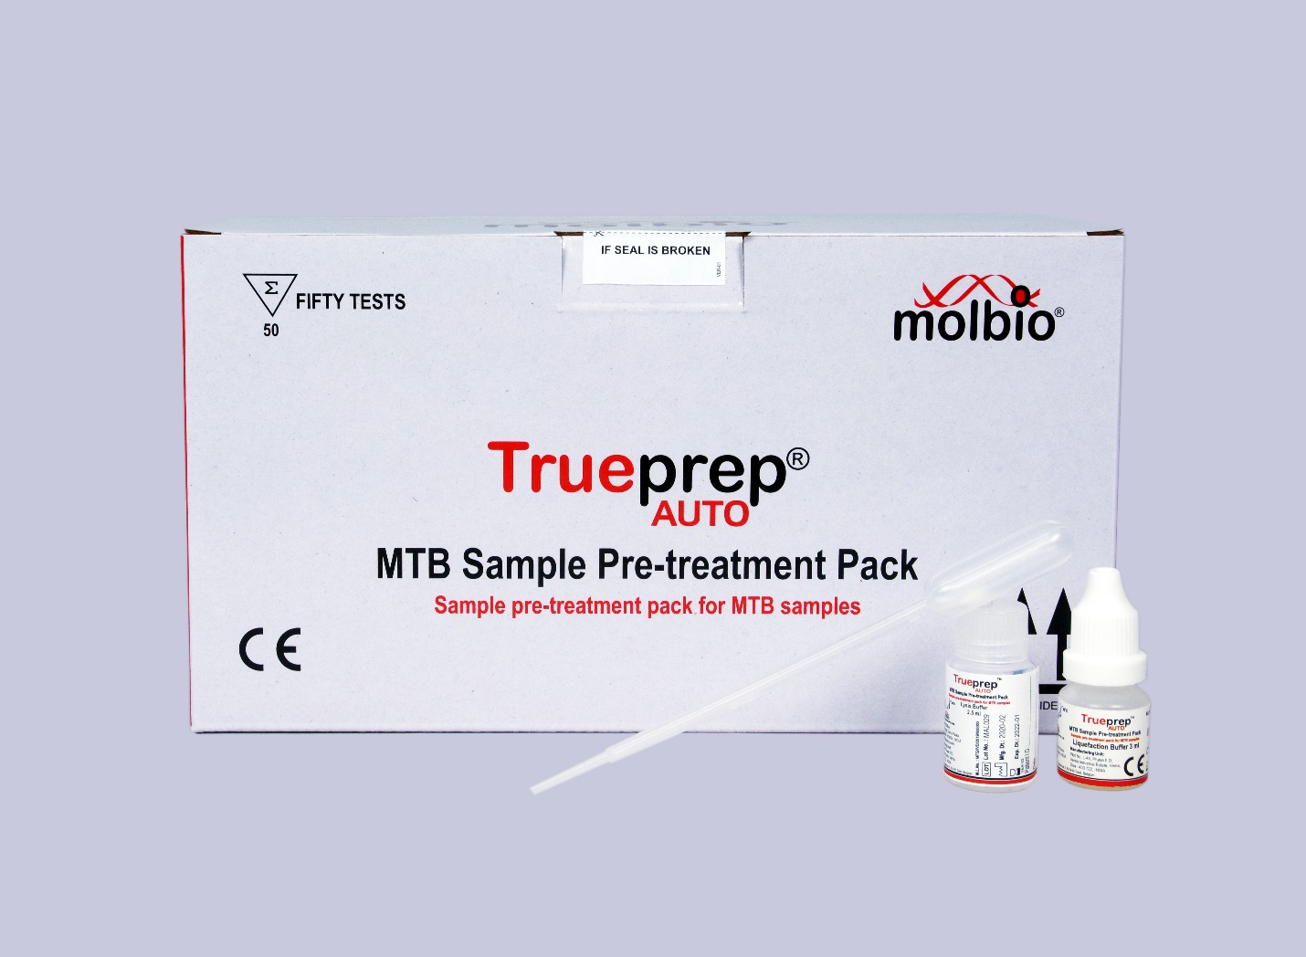

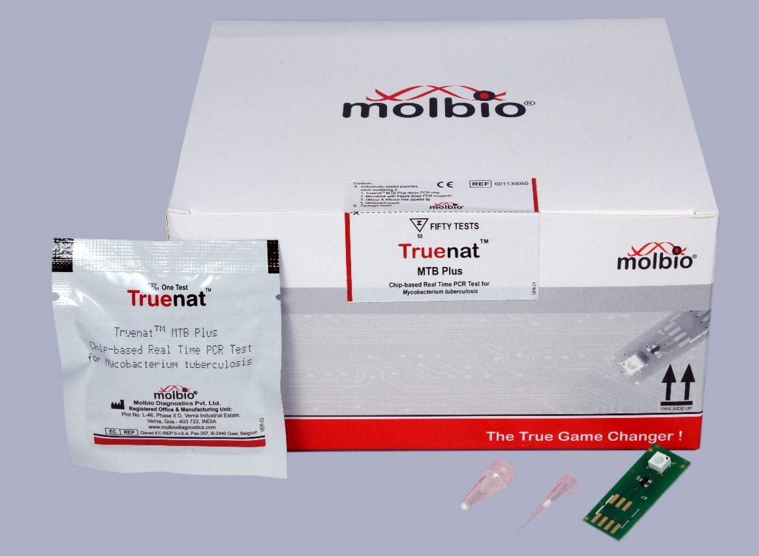
Reagents and Consumables
Reminder: There are three packets that include the reagents and consumables needed to run Truenat
Trueprep® AUTO MTB Sample Pre-treatment Pack
Trueprep® AUTO v2 Universal Cartridge Based Sample Prep Kit (for 25 or 50 tests)
Truenat Chip Pack (MTB, MTB Plus, or MTB-RIF Dx)

Slide 8
Ordering Reagents and Consumables
What to order?
From where?
How much?
How often?
How to assess the correctness of an order?
What is the lead time needed?
What is the reserve (buffer) stock needed?
Who is responsible for placing orders?

Slide 9
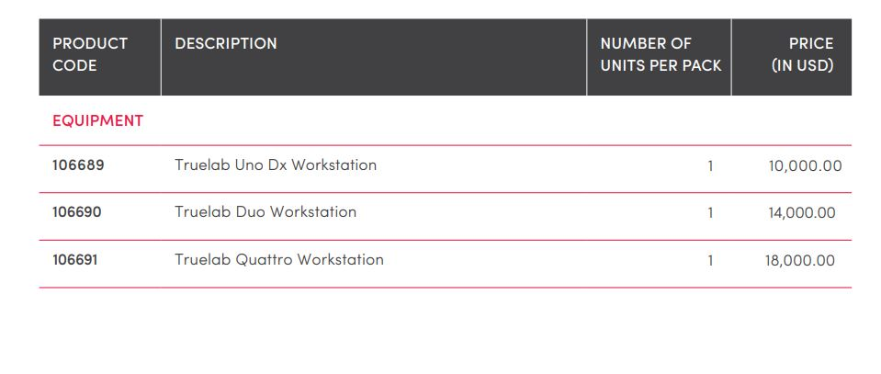
Pricing
Pricing of equipment, reagents and service packages through Stop TB Partnership’s Global Drug Facility (GDF) is outlined in the GDF Diagnostics Catalog

Slide 10
Storage Conditions and Shelf-Life of Consumables
Equipment | Recommended Storage Condition | Shelf Life
Chips | Storage temperature: 2°C – 30°C | 2 years shelf under recommended storage conditions Up to 6 months at a temperature under 40°C, if conditions do not allow for storage under 30°C, and up to 1 month at temperatures up to 45°C
Reagent packs (Sample Pre-treatment Pack and Prep Kit) | Storage temperature: 2°C – 30°C | 2 years under recommended storage conditions Please note that 2 years shelf is from the date of manufacture. The shelf life will be less upon arrival in the country and upon distribution to the sites.

Slide 11
Quantities for an Initial Order of Reagents
Average number of tests per day | Needed Instruments
 | 1 Truelab Analyzer Uno Dx +1 Truelab AUTO v2 Device | 1 Truelab Analyzer Duo + 1 Trueprep AUTO v2 Device | 1 Truelab Analyzer Quattro + 2 Trueprep AUTO v2 Devices
2 | 11 MTB/MTB Plus kits (Pretreatment, Prep, Chip kits, 50 tests each) 3 MTB-RIF Dx kits (50 tests each)
4 | 22 MTB/MTB Plus kits 5 MTB-RIF Dx kits
6 | 33 MTB/MTB Plus kits 7 MTB-RIF Dx kits
8 | 44 MTB/MTB Plus kits 9 MTB-RIF Dx kits | 44 MTB/MTB Plus kits 9 MTB-RIF Dx kits
10 |  | 55 MTB/MTB Plus kits 11 MTB-RIF Dx kits
16 |  | 88 MTB/MTB Plus kits 18 MTB-RIF Dx kits | 88 TB/MTB Plus kits 18 MTB-RIF Dx kits
24 |  |  | 132 MTB/MTB Plus kits 27 MTB-RIF Dx kits
32 |  |  | 175 MTB/MTB Plus kits 35 MTB-RIF Dx kits
Consider procuring a lower throughput model, unless testing is expected to increase over time.
Procure a higher throughput model to meet testing needs.
Notes:
Facilitators Note: Please indicate that this order is for 1 year of testing.

Slide 12
Order Quantities
The number of MTB-RIF Dx kits to order will depend on the anticipated proportion of people tested that will be MTB positive, and therefore in need of a test for RIF resistance.
Note: In addition, when buying through GDF, Molbio provides 20 free MTB-RIF Dx tests for every 100 MTB or MTB Plus tests.
Notes:
For now, the 20 free tests are only if the kits are bought through GDF.

Slide 13
Data Needed for Regular Forecasting
A: Average number of tests performed for the order period
B: Quantity of items needed per test
C: Quantity of an item required for one month
D: Buffer/ reserve stock
E: Stock currently available
F: Amount of stock currently needed by the lab, plus buffer
G: Unit in which stock can be ordered
H: Amount to be requested (considering pack size)

Slide 14
Activity: Regular Forecasting
Quarterly Supply Requirements for Truenat Testing
Laboratory: Regional Reference Laboratory
Region: Western Region |  | Supply Quarter 3
District: Urban |  | Year: 2021
Total tests performed in previous quarter, including failed tests (A): 159
Items | Quantity Needed per Test (B) |  | Stock for one month © = (A/3) * B | Stock for quarter with 1 month buffer (D)= C*4 | Stock on hand (E) | Calculated request (F) = D-E | Order unit (G) | Actual order (H) = F/G and round up
Trueprep® AUTO MTB Sample Pre-treatment Pack ( 20 tests per kit)
Trueprep® AUTO v2 Universal Cartridge Based Sample Prep Kit (20tests)
Truenat Chip Pack
Truenat MTB Plus Chip Pack
Truenat MTB-RIF-Dx Chip Pack
Notes:
Facilitator Notes:
Share:
In detail go through this exercise calculating these metrics. The Facilitator should help learners work through the calculations as a group. Use Module 3 Technical Modules for Xpert Stop TB Partnership - Global Laboratory Initiative (GLI) for guidance.
Share:
How to calculate how much to order:
Calculating how much to order: a = number of Xpert MTB/RIF tests performed (e.g, 210 tests) b = number of months (e.g, 3 months) c = average usage per month (a ÷ b) (e.g, 210 ÷ 3 = 70 tests per month) d = lead time (e.g, 4 months) e = stock in-hand (e.g, 140 cartridges) f = recommended buffer stock (2 months average usage = 140 tests) Minimum Xpert MTB/RIF cartridges to order for a four-month lead time: (c × d) – e + f = (70 × 4) – 80+140 = 340 cartridges
This is more complex and accounts for existing stock. *Unlike slide 8

Slide 15
STOCK MANAGEMENT

Slide 16
Stock Management
6 key components to maintain adequate stock of Truenat supplies
1
2
3
4
5
6
Do a monthly “stock count”
Maintain inventory records
Determine how much to order
Place orders in accordance with local ordering practices
Inspect and verify supplies received
Ensure proper storage of stock

Slide 17







Stock Management: Stock Log
Date and amount ordered
Date of receipt of item
Amount received
Lot number
Expiration date
What fields should be included in a stock log for Truenat?
Amount of used items
Balance of items still in stock
Notes:
Facilitator Note:
This slide will first only show the middle circle. The Facilitator will then lead a class discussion and help learners come up with the different content in the surrounding circles. Once the discussion reaches a logical stopping point, the Facilitator will show the rest of the content in the circles.

Slide 18
Stock Management:
Temperature and Shelf Life
Recommended storage conditions for the Truenat TB chips: 2°C–30°C
Shelf-life of reagents under recommended storage conditions: 2 years (at date of manufacture)
  GDF-negotiated minimum shelf life at time of readiness for delivery is 19 months
Notes:
Facilitator Notes:
Storage information is review. Remind participants of the following:
Recommended storage conditions for the Sample Pre-treatment Pack and Prep Kit: 2°C–40°C
If conditions do not allow for storage under 30°C – Truenat TB chips can be stored for up to 6 months under 40°C

Slide 19
Stock Management:
Storage and Expiry
Organize existing and new shipments by the expiry date
Notes:
Facilitator Notes:
Inform participants that the purpose of organizing by expiry date is so that supplies with the soonest expiry date will be used first.

Slide 20
QUALITY ASSURANCE (QA)

Slide 21
QA and Control
What types of quality control processes do you currently institute in your lab that would be relevant to Truenat?

Slide 22
Roles in Ensuring Quality
Laboratory manager is responsible for overseeing QA activities at larger facilities.
The Health Facility Quality Committee (HFQC) may provide oversight and coordination for QA activities at larger facilities.

Slide 23
Quality Assurance Program
A comprehensive discussion of the essential elements of a quality assurance system for any rapid TB diagnostic test may be found in the GLI Practical Guide to Implementing a Quality Assurance System for Xpert MTB/RIF Testing
Quality Assurance Program Components
Standardized documents
Use of good molecular biology practices
Competency assessment
Internal quality controls
External quality assessment (EQA)
On-site supervision
Continuous quality improvement processes
Notes:
Facilitator Notes:
Share:
Inform participants that Standardized documents include identification, tailoring and ensuring use.

Slide 24
Good Molecular Biology Practices
The Truenat TB test procedures require multiple hands-on steps as well as precision micro-pipetting.
Laboratory technicians should be trained on good molecular biology practices before operating Truenat.
One procedure that requires special care in training technicians is the micropipetting/dispensing of 6μl of DNA eluate solution into the well of the Truenat chip: a “steady hand” may also be an asset.
At least 10–15 specimens per week should be tested to maintain proficiency of staff conducting the Truenat TB tests.

Slide 25
Competency Assessment
Competency assessments of laboratory technicians should be performed after training and periodically (annually).
The positive and negative controls in the Truenat Positive Control Kit Panel-1 can be used for competency testing during hands-on training.
Notes:
Facilitator Note:
Share:
After competency assessments of laboratory techs there should be assessments of the knowledge and skills for performing each of the tasks involved in a diagnostic test.

Slide 26
Standardized Documents (SOPs)
SOPs should be provided as reference materials for technicians
Job aids are available in Annex 11 of the Truenat Implementation Guide:
Notes:
Facilitator Note:
Share:
The job aids available in Annex 11 of the Truenat Implementation Guide are:
Truenat PCR Process Flow: Sample to Result
Troubleshooting, Alerts, and Errors
Do’s and Don’t’s

Slide 27
Internal Quality Controls (IQC)
Internal quality controls are designed to detect, prevent, and minimize erroneous results in laboratories’ internal processes from pre-analytical, analytical and post-analytical phases.
Truenat TB assays incorporate an internal positive control that undergoes the same processes as the specimen; from extraction to amplification, thereby assessing the validity of the test run from sample to result.
The positive and negative controls in the Truenat control kit panel can also be used for lot-to-lot verification and assessment of reagents if the temperature of storage areas falls outside of the recommended ranges.

Slide 28
External Quality Assessment (EQA)
External quality assessment, or a proficiency testing program, is provided by an outside, accredited laboratory that offers statements of quality to the laboratory.
External quality assessment programmes for Truenat are under development, but not yet available.
EQA should include proficiency testing (PT) or blinded rechecking during assessments.
Notes:
Facilitator Note:
Share:
Even though external quality assessment programmes for Truenat are not yet available, it can be modeled after the proficiency testing programme used for the Xpert MTB/RIF test.
It is recommended to test 10-15 specimens per week to maintain proficiency of staff.

Slide 29
Initial Calibration / Verification Panels
Positive and Negative Controls
New Lot Testing (Lot-to-Lot Verification)
Maintaining QC Records of Lot Testing
Controls can be purchased as part of the Truenat™ Positive Control Kit- Panel I
Run positive and negative controls whenever:
A new shipment of Truenat TB test kits is received
For each new test kit lot
To assess reagents if temperature of storage areas falls outside recommended ranges
Review by testing site manager
Retention onsite for a period according to local or national policy
Notes:
Facilitator Notes:
Share with participants:
New lot testing (lot-to-lot verification):
Controls can be purchased as part of the Truenat™ Positive Control Kit- Panel I
Testing a central level or all at individual labs
New lot testing SOP template.
Positive and negative controls (e.g., PT samples, sputum or simulated samples of known reactivity) for new batches of reagents.
Maintaining and monitoring QC records of lot testing
Review by testing site manager
Retention onsite for a period according to local or national policy.

Slide 30
Regular Maintenance
1. Perform negative control tests monthly
2. Swab testing of work surfaces and instruments
3. Record preventative maintenance in a log
For further information: Truenat Implementation Guide
Notes:
Swab testing of surfaces and instruments is recommended monthly and negative control tests using Trueprep AUTO lysis buffer reagent and sterile PBS should be run monthly or when contamination is suspected (e.g., unusually high proportion of specimens with ‘MTB detected’). Note that if the benches are made of “sub-optimal” material (e.g. wood), you may likely get false positives, in that case then, consider only swab testing instruments.

Slide 31
Warranty and Repair
1-, 2-, 3-, 4-, and 5-year extended warranties are available from Molbio for US $1,220 per year through GDF
Comprehensive maintenance contract includes:
  Remote assistance/visit of service engineer
  Repair and replacement of parts
  In country travel and labor of company’s local agent
  Calibration chips and material which is used as service items

Slide 32
MONITORING QUALITY

Slide 33
General Laboratory Performance Indicators
Which of these indicators do you already track for other tests?
Indicator | Target
Number of tests performed, by type of test | N/A
Service interruptions | No interruptions
Stock outs | No stock outs leading to service interruption
Equipment down time | No equipment downtime leading to service interruption
Turnaround time (TAT) | 90% of results meet test-specific TAT
Test statistics (quality indicator) report | 100% reports completed by defined due date
EQA results | >90% EQA panels are passed
QC results | >90% QC results meet expected criteria
Specimen rejection | <1% specimens rejected
Customer satisfaction | >80% surveyed customers are satisfied
Technician productivity | Report average number of tests performed per month per technician

Slide 34
Performance Indicators for Truenat TB Tests
Indicator | Description |  | Target
Trueprep
Number and proportion of specimens for which DNA extraction was unsuccessful |  | Number of specimens for which DNA could not be extracted / Total number of specimens processed. Errors should be stratified by type, to enable troubleshooting | Initial test: <3% Repeat test: <1%
Truenat TB
Number and proportion of specimens with MTBC detected |  | Number of specimens with MTBC detected / Total number of specimens tested with successful results | Dependent on population tested and country drug-resistance prevalence and pattens
Number and proportion of specimens with MTBC not detected |  | Number of specimens with MTBC not detected / Total number of specimens tested with successful results | Dependent on population tested and country drug-resistance prevalence and pattens
Number and proportion of specimens with unsuccessful results (errors, invalid, no results) |  | Number of specimens with unsuccessful results / Total number of specimens tested. Errors should be stratified by type to enable troubleshooting | <3% Initial test: <10% Repeat test: <3%

Slide 35
Performance Indicators for Truenat TB Tests
Indicator | Description |  | Target
Truenat MTB-RIF Dx
Number and proportion of specimens with RIF resistance not detected |  | Number of specimens with RIF resistance not detected / Total number of specimens tested with successful results | Dependent on population tested and country drug-resistance prevalence and patterns
Number and proportion of specimens with RIF resistance detected |  | Number of specimens with RIF resistance detected / Total number of specimens tested with successful results | Dependent on population tested and country drug-resistance prevalence and patterns
Number and proportion of specimens with RIF resistance indeterminate |  | Number of specimens with RIF resistance indeterminate / Total number of specimens tested for RIF resistance | Dependent on population tested (e.g., proportion of patients with smear-negative TB)
Number and proportion of specimens with unsuccessful results (errors, invalid, no result) |  | Number of specimens with unsuccessful results / Total number of specimens tested for RIF resistance. Errors should be stratified by type, to enable troubleshooting | <3% for Truenat MTB or MTB Plus test Initial RIF-Dx test: <7% if reflexed from Truenat MTB Initial RIF-Dx test: <15% if reflexed from Truenat MTB Plus

Slide 36
Performance Indicators for Monitoring Patient and Sample Flow
Indicator | Description | Target
Laboratory Turnaround Time
Laboratory turnaround time | Time between receipt of specimen at the laboratory and result reporting | 2-24 hours
Turn-around time: sample collection to sample testing
Turn-around time: results availability to treatment initiation
Linkage to Care
Proportion of TB and RR-TB patients linked to appropriate care
What targets would you set for these?

Slide 37

Class Activity
up
Team up
10 minutes to work through
Present your answers and answers
#

Slide 38
SUMMARY
Forecasting and Quantification
It is important to monitor inventory, ensure supplies have not expired and forecasting future needs.
Quality Assurance
There are procedures and programs that allow for oversight and coordination of QA activities.
Monitoring Quality
Performance indicators help track and monitor each testing site to ensure quality tasks are carried out appropriately.

Slide 39
Knowledge Check – Question 1
1. What information is needed to determine how many supply packs to order each quarter?

Slide 40
Knowledge Check – Question 2
2. What are some practices to ensure good stock management?
Notes:
Answer:
Do a monthly “stock count”
Maintain inventory records
Determine how much to order
Place orders in accor-dance with local ordering practices
Inspect and verify supplies received
Ensure proper storage of stock
Keep a stock log
Organize existing and new shipments by the expiry date

Slide 41
Knowledge Check – Question 3
3. What are the main components of a quality assurance program?
Notes:
Answer:
Standardized documents
Use of good molecular biology practices
Competency assessment internal quality controls
External quality assessment (EQA)
On-site supervision
Continuous quality improvement processes

Slide 42
THANK YOU

