Slide 1
MODULE 6: BIOSAFETY AND SPECIMEN COLLECTION AND REFERRAL
Truenat® Tests for the Detection of TB and Rifampicin Resistance Central-Level Training​

Slide 2
ACKNOWLEDGEMENTS
These training modules were developed as a collaboration between the United States Agency for International Development (USAID) and its Infectious Disease Detection and Surveillance project (IDDS) and the Stop TB Partnership, as part of the introducing New Tools Project (iNTP). The content is based on the Stop TB/USAID/GLI Practical Guide to Implementation of Truenat™ Tests for the Detection of TB and Rifampicin Resistance, together with content provided by Molbio Diagnostics (Module 3). The material was technically reviewed and endorsed by the Global Laboratory Initiative.
All reasonable precautions have been taken by the authors to verify the information contained in this publication. However, the published material is being distributed without warranty of any kind, either expressed or implied. The responsibility for the interpretation and use of the material lies with the reader.
In no event shall the authors be liable for damages arising from its use. Development of this document was made possible with financial support from the United States Agency for International Development. The views expressed herein are those of the authors and do not necessarily reflect those of the U.S. Agency for International Development or the U.S. Government.

Slide 3
Introduction
This module introduces biosafety measures and procedures for specimen collection and referral.
These measures are specific to use of the Truenat rapid molecular test
Information in this module is informed by the Global Laboratory Initiative’s “Laboratory Safety” handbook.

Slide 4
01.
Introduction
03.
Specimen Collection
04.
Specimen Referral
05.
Summary
Module 6: Specimen Collection and Referral
Course Outline
02.
Biosafety Measures and Risk

Slide 5
Learning Objectives
By the end of this module, participants should be able to:
Demonstrate good biosafety practices and risks when performing Truenat testing
List the equipment needed to collect a quality sputum specimen
List the steps for collecting a quality sputum specimen
List the steps for packaging sputum specimens
Describe storage requirements for collected specimens
Understand the process for specimen referral
Notes:
Terminal objective: Explain the process for collecting specimen.

Slide 6
BIOSAFETY MEASURES AND RISK

Slide 7
GENERAL PRINCIPLES OF BIOSAFETY
Biosafety has three key parts, all of which are needed to handle TB bacilli safely:
Primary: Safe working practices to minimise creation of infectious aerosols and prevent spills Equipment that is ‘fit for purpose’, correctly used and maintained
Secondary: Infrastructure and layout to support the primary activities
Tertiary: Buildings to contain the laboratory and its activities

Slide 8
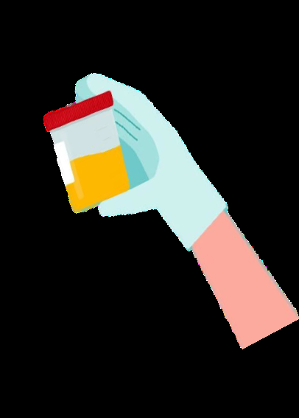
IMPORTANCE OF BIOSAFETY
The level of biosafety risk depends on:
Type of procedure
Workload
Consistency
Bacillary load
Laboratories present numerous hazards to staff, and not all are immediately obvious. Safe working practices are designed to
Reduce the risk of infection or injury to you, co-workers, and the community
Protect the patient from incorrect results
The main procedural risk in a TB laboratory is the generation of aerosols

Slide 9
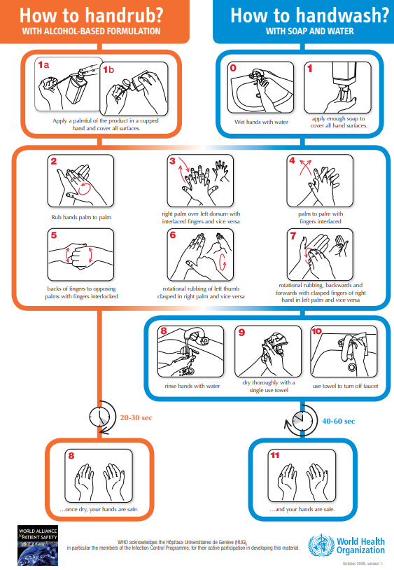
STANDARD MICROBIOLOGICAL PROCEDURES
Practices that are common to all laboratories
These practices must include
Not eating, drinking, or applying cosmetics in the laboratory
Washing hands after working with infectious materials and before leaving the laboratory
Routinely decontaminating work surfaces
Notes:
https://www.who.int/gpsc/tools/GPSC-HandRub-Wash.pdf

Slide 10
ADDRESSING BIOSAFETY
This module will help you:
Understand and assess the risks
Laboratory infrastructure, design and layout
Personal protective equipment
Biological safety cabinets
Generation and prevention of aerosols
Spills
Waste management

Slide 11
ASSESSING RISK

Slide 12
RISK BIOSAFETY LEVELS
BSL-4
High Risk
There are four biosafety levels (BSLs).
Each level has specific controls (laboratory practices, safety equipment, and facility construction) for containment of microbes and biological agents.
The primary risks that determine levels of containment are:
Infectivity
Severity of disease
Transmissibility
Nature of the work conducted
Origin of the microbe or the agent in question
Route of exposure
BSL-3
BSL-2
BSL-1
Low Risk

Slide 13
CHARACTERISTICS OF BIOSAFETY LEVELS
Biosafety level |  | Examples
BSL-4 | Microbes are dangerous and exotic, posing a high risk of aerosol-transmitted infections. Infections are frequently fatal without treatment or vaccines. All work with the microbe must be performed within an appropriate Class III Biological Safety Cabinets (BSC), or by wearing a full body protection suit with gloves, mask, and eye protection. | Ebola Marburg viruses
BSL-3 | Microbes can be either indigenous or exotic. They can cause serious or potentially lethal disease through respiratory transmission. Laboratorians are under medical surveillance and might receive immunizations for microbes they work with. Access to the laboratory is restricted and controlled at all times. | Tuberculosis
BSL-2 | Microbes pose moderate hazards to laboratorians and the environment. Microbes are typically indigenous and associated with diseases of varying severity. | COVID-19 HIV
BSL-1 | Non-pathogenic organisms or non-aerosol pathogens. Wear personal protective equipment (PPE), work on open laboratory bench, follow standard microbiological practices. | Non-pathogenic strain of E.coli

Slide 14
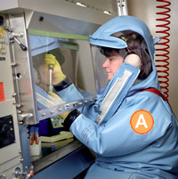
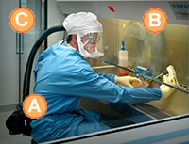
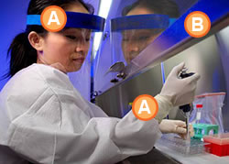
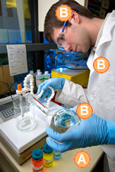
BIOSAFETY MEASURES ACCORDING TO RISK LEVELS
 | PPE |  | BSC | Facility | Lab access
BSL-4 | Wearing full body protection and air supplies |  | All work performed within an appropriate Class III BSC or Wearing a full body suite and air supplies |  | Change clothing before entering Shower upon exiting Decontaminate all materials before exiting
BSL-3 | Yes + face shield and respirator |  | All work done under the Class II BSC Autoclave or an alternative method of decontamination for proper disposal | Hands-free sink eyewash near exit Exhaust air cannot be recirculated | Entrance to the lab is through two sets of self-closing and locking doors
BSL-2 | Yes + face shield |  | Procedures that can cause infection from aerosols or splashes are performed within a Class I BSC | Self-closing Sink and eyewash | Access to lab limited to when performing work
BSL-1 | Standard microbiological practices are followed |  | Work can be performed on an open laboratory bench or table

Slide 15
RISK PRECAUTION LEVELS
Risk level of TB | Laboratory activities | Assessment of risk
Low risk | Preparation of specimens for TB microscopy or Xpert MTB/RIF TrueNAT | Low risk of generating infectious aerosols from specimens Low concentration of infectious particles
Moderate risk | Processing and concentration of specimen for Xpert MTB/RIF Inoculation on primary culture media; splitting specimens; direct DST (e.g., LPA on processed sputum) | Moderate risk of generating infectious aerosols from specimens Low to moderate concentration of infectious particles
High risk | Culture manipulation for identification DST or LPA on cultured isolates | High risk of generating infectious aerosols from specimens High concentration of infectious particles

Slide 16
LABORATORY INFRASTRUCTURE

Slide 17
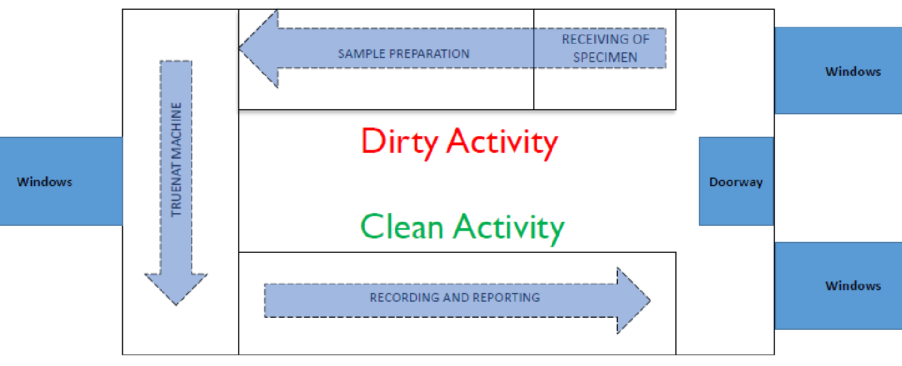
VENTILATION AND LABORATORY SETUP
A biosafety cabinet is not essential for Truenat testing on sputum.
When climate prevents windows from being opened, considerations should be given to using mechanical ventilation systems, e.g., exhaust fans

Slide 18
PERSONAL PROTECTIVE EQUIPMENT

Slide 19
MATRIX OF RECOMMENDED PPE ACCORDING TO ACTIVITY
Activity | Who should wear | Gloves | Disposable lab gown* | Dedicated lab and / or shoe cover | Head cover | Face shield / goggles | Fit-tested N95, N100, P100 respiration**
Specimen Collection (If going with patient to collect)*** | Collection unit staff | Double gloves recommended | Recommended |  | Based on risk assessment | Based on risk assessment | Recommended
Specimen packaging | Collection unit staff | Double gloves recommended | Recommended | Recommended | Based on risk assessment | Based on risk assessment | Recommended
Receiving of Sealed Specimen Package and Accompanying Documents | Laboratory staff | Recommended | Recommended |  |  |  | Based on risk assessment (Face mask may be used as substitute based on risk assessment)
Specimen Transport | Specimen transporter | Recommended |  |  |  |  | Based on risk assessment (Face mask may be used as substitute based on risk assessment)

Slide 20
MATRIX OF RECOMMENDED PPE ACCORDING TO ACTIVITY
Activity | Who should wear | Gloves | Disposable lab gown* | Dedicated lab and /or shoe cover | Head cover | Face shield / goggles | Fit-tested N95, N100, P100 respiration**
Unboxing of Specimen Package for Specimen Receiving, Sorting and Verification | Laboratory staff | Double cloves Recommended | Recommended | Recommended | Based on risk assessment | Based on risk assessment (Recommended BSC) | Recommended
Specimen Processing | Laboratory staff | Double cloves Recommended | Recommended | Recommended | Recommended | Based on risk assessment (Recommended BSC) | Recommended
Decontamination of specimen | Laboratory staff | Double cloves Recommended | Recommended | Recommended | Based on risk |  | Recommended

Slide 21
PROPER ORDER FOR DONNING PPE
Each country/facility must evaluate its risks and decide on the level of PPE, and donning method, appropriate for the different procedures undertaken.
Perform hand hygiene
Put on gown
Put on shoe covers*
Put on gloves
Put on mask/fitted respirator*
Put on face shield / goggles*
* If applicable
modified from: https://msdh.ms.gov/msdhsite/index.cfm/14,4530,188,547,pdf/Donning_Personal_Protective_Equipment.pdf

Slide 22
PERSONAL PROTECTIVE EQUIPMENT: GLOVES & SHOES
Gloves:
Disposable, powder-free
In light of the COVID-19 pandemic, the use of double gloves is recommended
Wearing gloves can give technicians a false sense of security
Do not reuse or wear gloves outside of the laboratory
Regular and thorough handwashing is most essential
Shoes:
Shoes must cover the toes, upper part of the feet, and have closure to the back of the heel
Dedicated laboratory shoes should be available in the facility

Slide 23
PERSONAL PROTECTIVE EQUIPMENT: LABORATORY GOWN & COAT
Laboratory gown:
Appropriate size
Buttoned
Covers the whole arm with elastic cuff
Length should be up to knee when standing and should cover entire lap when sitting
Laboratory coat:
Leave coats at worksite
Fasten coat when worn
Do not wear outside of lab
Disinfect before laundry

Slide 24
PERSONAL PROTECTIVE EQUIPMENT: RESPIRATORS & MASKS
Due to the current pandemic, the use of respirators is now recommended.
Respirators must be fitted to the face (fit-testing)
Surgical masks do not provide protection to the wearer against inhaling infectious aerosols
Respirators protect the wearer from inhaling droplet nuclei.
Masks prevent the spread of microorganisms from the wearer.

Slide 25
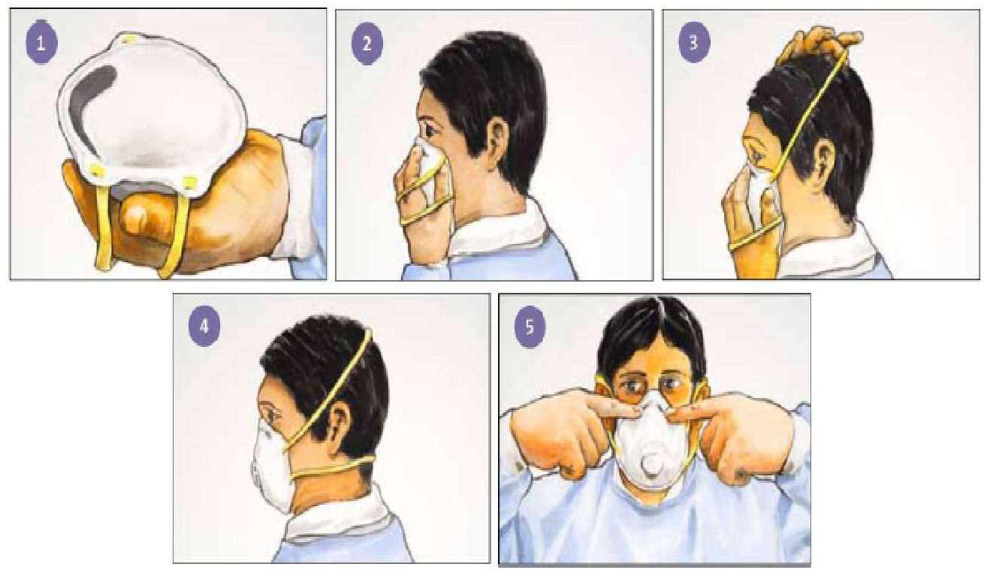
PERSONAL PROTECTIVE EQUIPMENT: RESPIRATORS & MASKS
Properly wearing a respirator

Slide 26
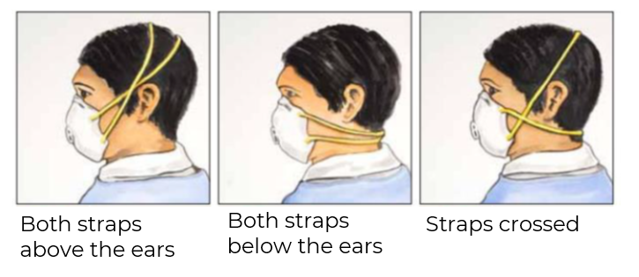
PERSONAL PROTECTIVE EQUIPMENT: RESPIRATORS & MASKS
Common mistakes in wearing respirators

Slide 27
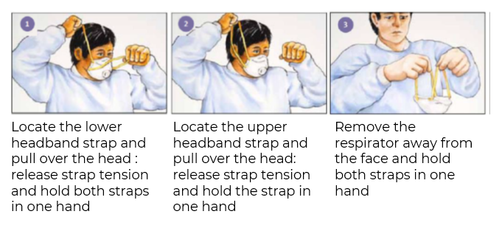
PERSONAL PROTECTIVE EQUIPMENT: RESPIRATORS & MASKS
Properly removing a respirator

Slide 28
PERSONAL PROTECTIVE EQUIPMENT: FACE SHIELDS & GOGGLES
Due to the COVID-19 pandemic, the use of face shields and goggles is recommended when there is no BSC in the facility.

Slide 29
BIOSAFETY CABINETS

Slide 30
BIOSAFETY CABINETS
Biosafety cabinets are categorized as Class I, Class II or Class III
Class II BSCs draw around 70% of purified air from the HEPA filter above the work area and around 30% air through the front grille.
Class II provides protection for the user, environment and the work area.
There are four types of Class II: A1, A2, B1 and B2
Class II, Type A2 BSCs are recommended for all TB work; however, they are not necessary for Truenat

Slide 31
PERFORMING TESTS WITHOUT BSC
Near point of care assays, like Truenat, can be performed on the bench without BSC with the following essential minimum biosafety measures for a TB laboratory:
Adequate ventilation and directional airflow* are required
Bench spaces should be separate from areas where samples are received, and from administrative areas e.g. paperwork and telephones
Appropriate PPE and well-trained staff on Good Laboratory Practice
Bench tops should be impervious to water, and resistant to the chemicals and disinfectants used in the laboratory
Storage space must be adequate to hold supplies for immediate use and prevent clutter on bench tops.
Minimising the generation of aerosols by using good microbiological techniques
Appropriate handling of leaking sample containers (e.g., decontaminate container before processing, or discard and request a fresh sample)
*air flows from the technician, across the work area along with potentially infectious material, then away from occupied areas of the room and outside the laboratory
Tuberculosis laboratory biosafety manual, WHO
Notes:
Good microbiological techniques include taking care when opening specimen containers which may have been shaken during transportation to the laboratory
Samples need to be transported to the laboratory in an upright position to minimise leakage

Slide 32
GENERATION AND PREVENTION OF AEROSOLS

Slide 33
GENERATING AEROSOLS
In the TB laboratory, all aerosols should be considered as potentially infectious. Aerosols are capable of being inhaled and establishing infection. Once they settle onto a surface, they are not re-aerosolised, and are no longer infective. However, they may contaminate specimens, equipment, consumables, and reagents creating a cross-contamination risk.
High-risk procedures and practices that may increase the potential of creating aerosols (which then become droplet nuclei) include
Mechanical (vortexing, centrifugation, shaking)
Pouring/tipping
Pipetting

Slide 34
MINIMIZING AEROSOL FORMATION
Allow enough contact time of liquefaction buffer to sample, including adequate standing time.
This ensures:
Adequate liquefaction of samples will enable complete exposure of TB bacilli to lysis buffer
Pipettable consistency of the sample to prevent forceful pipetting
Settlement of aerosols possibly produced during swirling/gentle mixing
Updated Guidelines on Handling of Specimens for TB Testing in the Presence of Coronavirus Disease (COVID-19) Community Transmission

Slide 35
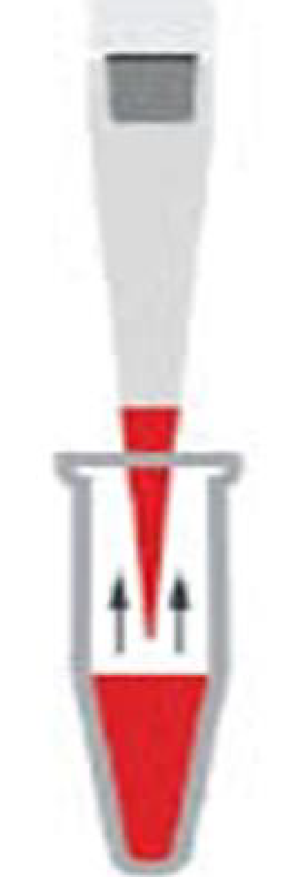
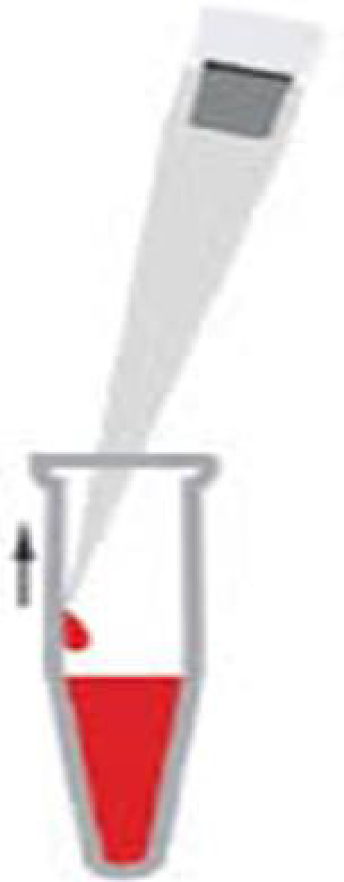
MINIMIZING AEROSOL FORMATION
1. Do not forcibly expel air from a pipette when aspirating the liquefied and lysed sputum sample
2. Place the pipette against the inner wall of the lysis buffer bottle when dispensing liquified sputum sample
3. Do not forcibly expel lysis buffer sample while dispensing into the cartridge

Slide 36
MANAGING SPILLS

Slide 37
MANAGING AND RESPONDING TO SPILLS
A spill outside of a BSC is a major incident and places staff at greatest risk
Spills usually involve liquids and aerosols of infectious droplet nuclei are generated
Even in the best laboratories, infectious spills do occur. Spill management procedures and training are a fundamental requirement for working safely in a TB laboratory. Management must ensure procedures are in place, reviewed regularly and that staff are trained in the use of the spills kit. Conducting an effective debrief and implementation of corrective actions will reduce the likelihood of future spills.

Slide 38
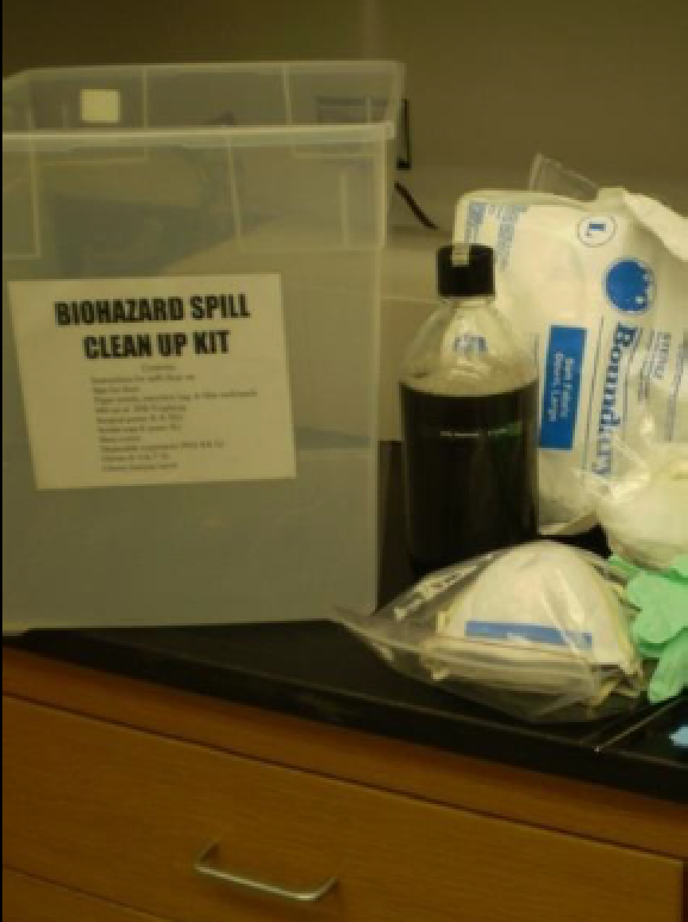
MANAGING AND RESPONDING TO SPILLS
Always keep two spill response kits in lockable containers in the laboratory.
Each kit will include a contents list detailing each item, the quantity, and expiry dates for stock solutions should be placed on the container lid and checked quarterly by staff
Recommended spill kit contents:
Laboratory gowns (disposable) and goggles
Box of gloves (different sizes) and respirators (N95/FFP2)
Paper towel, cotton wool or absorbent cloth
Soap and chloramine tablets
Dustpan and sharp container

Slide 39
COMMONLY USED DISINFECTANTS FOR SPILLS
Disinfectant | Advantages | Disadvantages
Sodium hypochlorite Should be used at a concentration of 10% in water Solutions should be prepared daily Chlorine residue can be removed with alcohol. | Broad spectrum of antimicrobial activity Readily available Inexpensive Property to decontaminate and degrade DNA | Corrosive to metals Inactivated by organic matter Discolors fabrics Unstable
Alcohol | Does not leave residue on treated items Can be used in BSC and bench top | Volatile Flammable Does NOT decontaminate and remove DNA
Phenolic compounds Should be used at a concentration of 10% in water | Used for decontaminating equipment and single-use items prior to disposal | Inhalation and dermal exposure irritates skin Ingestion is considered toxic Because of its toxicity and odor, phenol derivatives are generally used in place of phenol Does NOT decontaminate and remove DNA

Slide 40
WASTE DISPOSAL

Slide 41
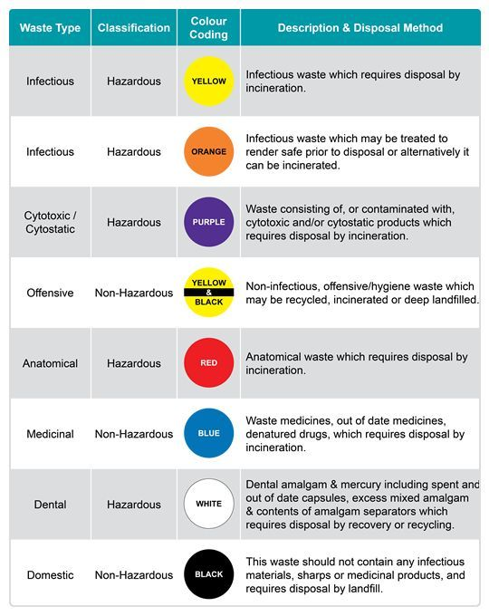
WASTE DISPOSAL
TB medical waste is category B and requires an autoclave or incinerate.
Be sure to follow country policies and guidelines.

Slide 42
SAFE MANAGEMENT OF TB-CONTAMINATED MEDICAL WASTE
Manage like any other regulated medical waste.
Use typical engineering and administrative controls, safe work practices, and PPE to prevent exposure to the waste streams (or types of wastes);
Including any contaminants in the materials they manage
Measures can help protect workers from sharps and other items that can cause injuries or exposures to infectious materials.
For regulated medical waste information, consult the regulated medical waste information in CDC’s Guidelines for Environmental Infection Control in Health-Care Facilities. This document provides information on management of waste streams from hospitals and other healthcare facilities.
Notes:
https://www.cdc.gov/infectioncontrol/pdf/guidelines/environmental-guidelines-P.pdf
https://www.cdc.gov/coronavirus/2019-ncov/hcp/faq.html

Slide 43
LABORATORY WASTE MANAGEMENT & DISPOSAL
Where decontamination cannot be performed in the laboratory area or onsite:
Package the contaminated waste in an approved (sealed and leak-proof) manner for transfer to another facility with decontamination capacity.
Handle waste from testing (suspected or confirmed) TB patients as all other biohazardous waste in the laboratory.
Completely soak waste materials in a 1:10 dilution of household bleach
Disposal should be carried out following existing local and national regulations on management of healthcare waste
All materials used should be considered contaminated!

Slide 44
MENTAL CHECKLIST FOR BIOSAFETY AND RISK MANAGEMENT:
Correct PPE
Adequate collection supplies
Collect the appropriate specimen
Use appropriate collection material/equipment
Practice IPC during/after collection
Label specimen
Decide where to test
In house or refer? Referral contact and process
Adequate material for storage
Adequate material for packaging and shipping
Labels and documentation
Appropriate handling of medical waste

Slide 45
USEFUL BIOSAFETY RESOURCES
WHO Tuberculosis Laboratory Biosafety Manual
Available at: https://www.who.int/publications/i/item/9789241504638
2. WHO Laboratory Biosafety Manual, 4th Edition
Available at: https://www.who.int/publications/i/item/9789240011311
3. CDC Biosafety in Microbiological and Biomedical Laboratories (BMBL), 6th Edition
Available at: https://www.cdc.gov/labs/pdf/SF__19_308133-A_BMBL6_00-BOOK-WEB-final-3.pdf

Slide 46
SPECIMEN COLLECTION

Slide 47
SPUTUM SPECIMEN COLLECTION: CONTAINER SPECIFICATIONS To be customized by each country
30-50 ml capacity
Translucent or clear material
Sides and walls that allow easy labelling
Single-use combustible material
Leak-proof with a screw-cap
Wide mouth
Insert a picture of container used by the country

Slide 48
SPUTUM SPECIMEN COLLECTION: SAFETY
When providing a sputum specimen, a patient may produce infectious aerosols and therefore biosafety precautions are needed:
Instruct the patient to cover his or her mouth when coughing prior to sample collection. When providing the sample, ask that they cough directly into the container.
Never collect sputum in the laboratory
Collect sputum away from other people in a well-ventilated space following the NTP’s guidelines
Do not stand in front of the patient during specimen collection!

Slide 49
SPUTUM SPECIMEN COLLECTION: PATIENT EDUCATION AND INSTRUCTIONS
Saliva or nasal secretions are unsatisfactory
Specimens should not contain food or other particles
Patients should be instructed to take the following steps to produce the best specimen:
Wash your mouth with clean water to remove food and other particles
Inhale deeply 2–3 times and breathe out strongly each time
Cough deeply from your chest to produce sputum
Place the open container close to your mouth to collect the specimen; do not get sputum on the outside of the container
Wash your hands after collecting the sample

Slide 50
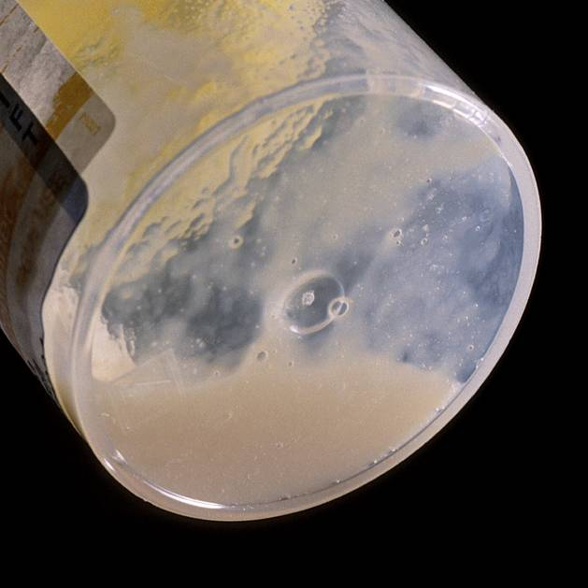
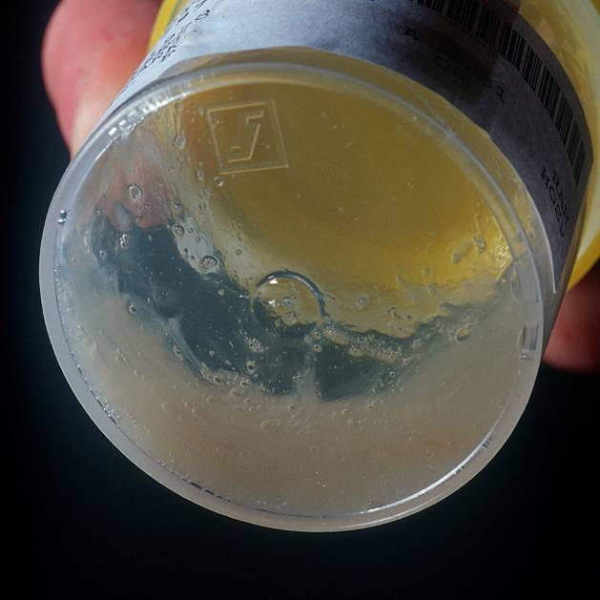
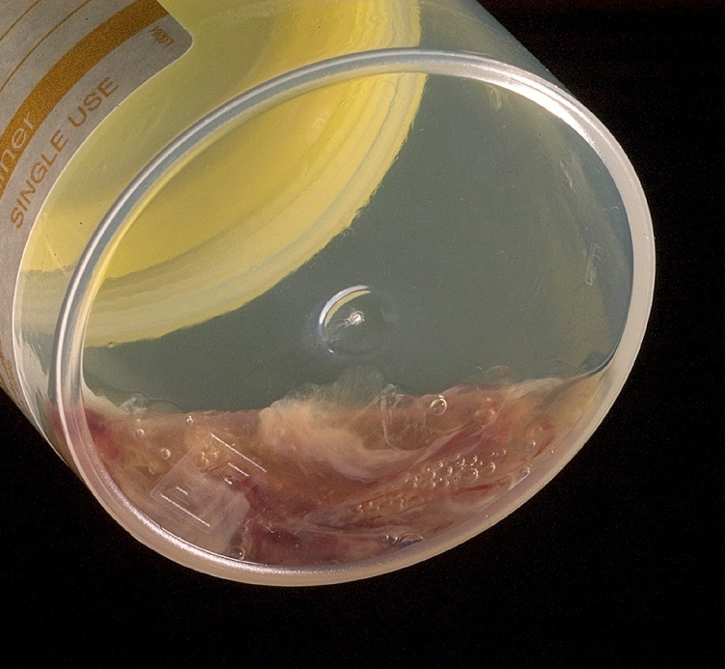
COLLECTING A GOOD QUALITY SPECIMEN
Obtaining an adequate quantity of good quality sputum is critical to ensure accurate test results
Induced or expectorated sputum specimens may be used
Spot and morning sputum samples can be collected from each patient
Proposed algorithm describes the collection of at least one initial specimen to be used for Truenat testing and the collection of additional specimens as needed
For best results, obtain >1ml of purulent/mucoid sputum (see below)
Purulent
Mucoid
Blood-stained
Photo credit A. van Deun

Slide 51
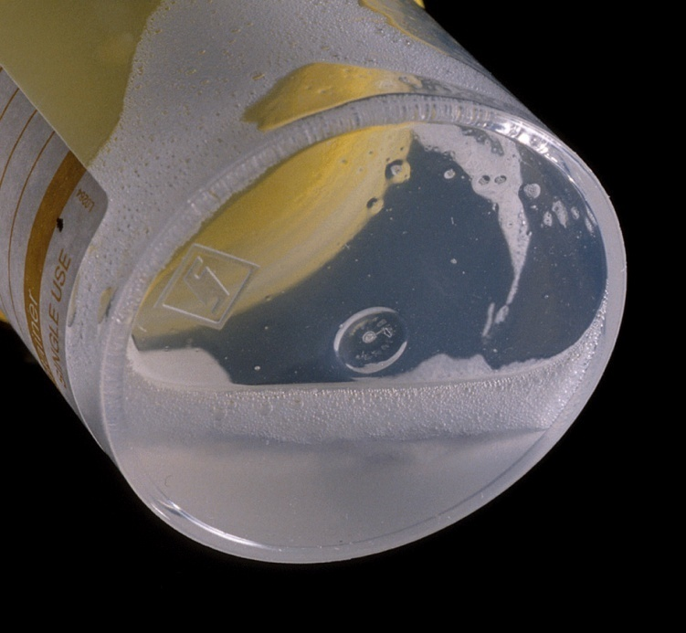
SPUTUM SPECIMEN COLLECTION: POOR QUALITY
Poor quality specimens will give poor quality results
Salivary (thin, watery, or comprised mainly of bubbles)
Photo credit A. van Deun

Slide 52
SPUTUM SPECIMEN COLLECTION: LABELLING
Label the container with the patient’s name, identification number, and date of collection
Label the outer sides of the container with permanent ink
Never label the lid
Complete the Laboratory Request Form according to NTP guidelines for the country
Once specimens are collected and labelled, they can be packaged and sent to the Truenat testing site.

Slide 53
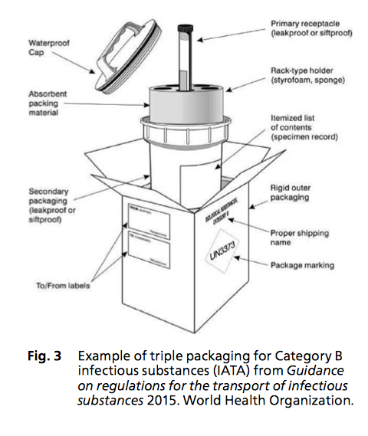
SPUTUM SPECIMEN PACKAGING: TRIPLE-PACKAGING TO ENSURE BIOSAFETY
Primary packaging
Wrap the leak-proof container in cotton wool or paper towels in a sufficient quantity to absorb the entire contents in case of leaks
Secondary packaging
Place the wrapped container inside a secondary container, such as a self-sealing plastic bag or another container
Place secondary container in a rack to prevent leakage
Tertiary packaging
Place the secondary container and its contents in an approved safety cooler box or another appropriate container in an upright position
Place a biohazard sign – with markings and labelling appropriate for the specimen category – on the tertiary container

Slide 54
Packaging and Storing the Specimen
Specimens should be stored in a refrigerator or a cool box between 2°C to 8°C and transported to the Truenat testing site.
Specimens should be well parceled in a specimen flask or transportation box
During transportation, specimens should be kept between 2°C to 8°C in ice packs.
Once specimens reach Truenat sites, specimens needs to be brought to room temperature before processing with Trueprep® AUTO MTB sample pre-treatment pack.
Notes:
Shannon: Note in the FG we are targeting facilities without UPS, so their ability to store samples for more than a few hours is probably limited.

Slide 55
Class Activity
Pair Off
Place the index cards in order based on the steps in the specimen collection process.
One observe and assist
#
Notes:
Facilitator Note:
The Facilitator will ask the learners to pair off into groups of 2. Then the Facilitator will give each participant a stack of index cards with steps for properly collecting a specimen. The participants will take turns putting the index cards in the correct order. While one participant is putting the cards in the correct order, the other should observe and follow along with the notes. The observing participant should assist and remind the participants of the steps In the processes as needed. Once finished, they should switch places.
Good activity! Just make sure in the FG, the materials for this are mentioned in the FG.
maybe this shouldn't be in groups. It seems the 2nd person will relaly know the steps after watching the first person, but having it in groups will reduce the amount of index cards need to create.
Is ICF creating these printouts? It can be easily created in Word and then once printed just cut out.

Slide 56
SPECIMEN REFERRAL

Slide 57
Lab Forms
National programs should tailor this content to show what the actual lab forms look like and walk through how they should be filled in.
Notes:
Facilitator Note:

Slide 58
Integrated Specimen Referral Systems
A specimen referral system may need to be developed for Truenat.
Truenat testing should be incorporated into larger diagnostic network specimen referral system.
GLI’s Guide to TB Specimen Referral Systems and Integrated Networks provides guidance on establishing integrated solutions for specimen referral.
Notes:
Facilitator Note:
Share:
A specimen referral system may need to be developed for Truenat depending on where Truenat is placed in the diagnostic network (e.g., at point of care or in peripheral laboratories).

Slide 59
Results Reporting
Electronic reporting of digital results should be used where available followed by paper reporting.
Truenat testing sites must ensure that results are transmitted back to requesting facility.

Slide 60
Questions to Consider about Sample Flow
How are patients referred for TB screening and testing?
Are patients referred from the community to the facility for TB Testing?
Are specimens collected at the community level and transported to the facility for testing or are they testing at the community level and TB patients referred to the facility for TB/DR-TB Rx initiation?
How are diagnosed patients referred for TB-DR-TB clinical monitoring?

Slide 61
Specimen Referral System-Example
Site 2
Truenat (ACF or facility)
Site 3
BMU or DR-TB clinic
Site 1
No Truenat/ACF
Screen the patient
Send specimens for testing (Site 2)
Detect TB
Request 2nd specimen to NTRL for culture / DST
Electronic transmission of results to either Site 1, 3, or 4 *register result
Receive electronic Truenat results
Initiate treatment or
Refer patient to (site 4) another facility for Rx
Initiate treatment
If RR-TB or DS-TB patient cannot be treated at site 1: Electronically send or print results and attach to referral form with patient to where patient has been referred (TB BMU or DR-TB clinic).
Site 4
Another site chosen by patient
Notes:
Discuss with the participants on Specimen referral system on each site
Ask questions on C&DST is 2nd sample collected by referring facility? Where are results sent?)

Slide 62
SUMMARY
Biosafety
Biosafety is the safe handling and containment of infectious microorganisms and hazardous biological materials.
The main procedural risk in a TB laboratory is generation of aerosols.
Use of engineering controls, PPE, and administrative controls are important components of TB laboratory biosafety.
Specimen Collection
Procedures for completing lab request forms, sputum collection, packaging, storage, and transportation is by collecting good quality specimens, using the algorithm to describe the collection of specimen and results reporting.
Specimen Referral
When a specimen is not collected on site, you must store at the collection site following the appropriate temperature and transportation process.

Slide 63
Knowledge Check – Question 1
What equipment is needed for specimen collection?
Notes:
Answer: get answer once the equipment slide is revised.

Slide 64
Knowledge Check – Question 2
At what temperature / where should specimens be stored before being pre-treated?
At what temperature should specimens be stored after being pre-treated?
Notes:
Answer: 2°C to 8°C

Slide 65
Knowledge Check – Question 3
A sputum specimen is collected at a primary health care facility and tested using Truenat for MTBC and RIF-resistance. The specimen is revealed to be positive for both.
Where should the specimen be referred next?
Where should results be sent?
Where should the patient be referred?
Notes:
Answer: True

Slide 66
THANK YOU

