Slide 1
TB Alert India for a future without tuberculosis “TB Free India” Om Sai Ram

Slide 2
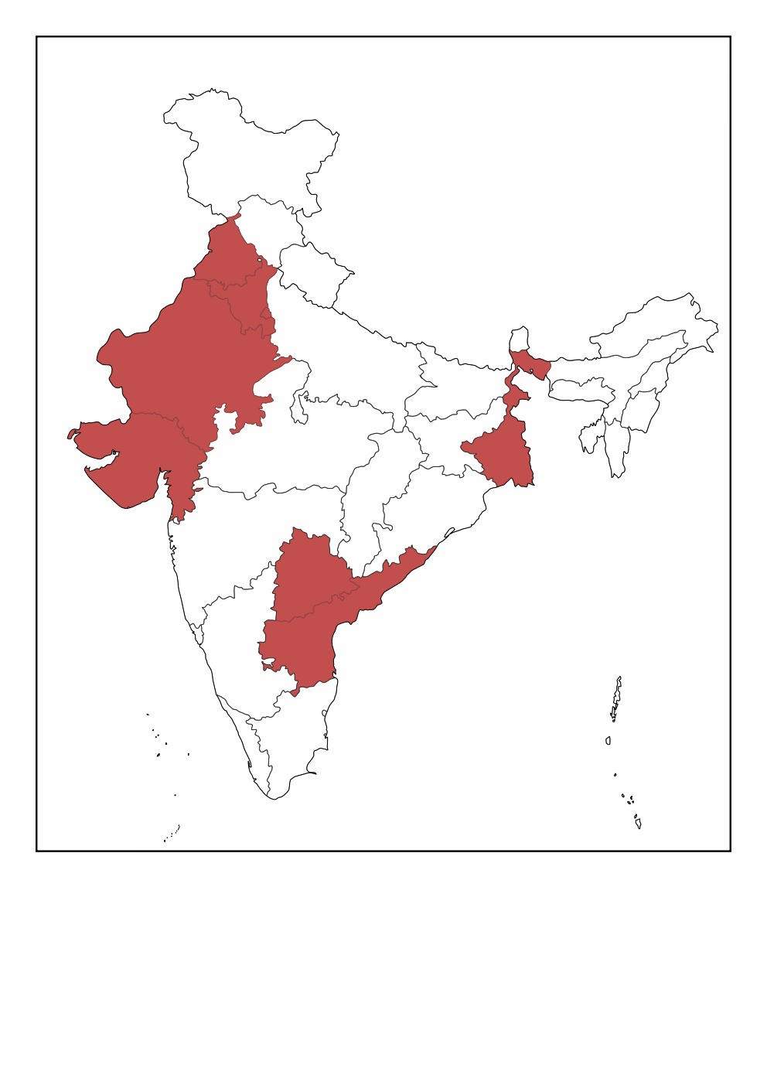
TB Alert India – For a Future without TB
Mission of TBAI is to prevent morbidity and
mortality associated with TB and providing holistic patient centric TB care
through addressing psycho-social and economic aspects which
affect uptake of TB services (testing and treatment services) and
other factors hindering the TB elimination.
Mission
Andhra Pradesh
Telangana
New Delhi
Haryana
Punjab
West Bengal
Rajasthan
Gujrat

Slide 3
RIPEND Project Experience
‹#›
Roping Informal Providers for enhance TB detection in Telangana state, India.
Implemented across 19 TUs from 9 districts ( 8 TUs for a period Oct 2018 to Dec 2021 and the remaining 11 TUs were added through scale up grant from Jan 2020 onward.)
Funded by Stop TB Partnership – TB Reach Wave 6 and Scale up
Mapped and engaged around 1700 providers in the project.
Indicator | Result Achieved
~ Out Patient Department (OPD) clients screened for TB by the providers | 3.96 million
~ people with TB symptoms referred for test | 28,530
~ of above tested for TB | 28,037
~ Found bacteriologically confirmed TB | 3547 (Against an estimated target of 2759) (29% more than the target)
~Found All Forms TB | 4964 (Against an estimated target of 2956) (68% more than the target)

Slide 4
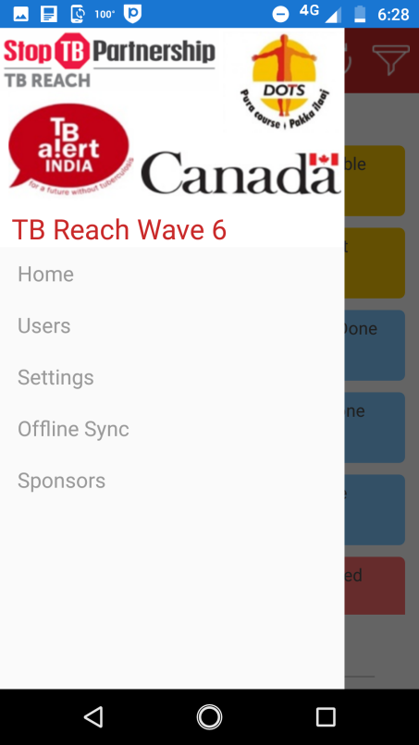
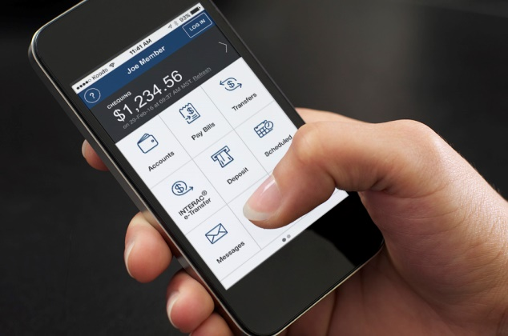
Technology Used
IT based mobile application was developed to fast track TB symptomatic individuals for testing.
Project staff / NTEP staff gets the alert, connect to counsel the individual, facilitate to link with the facility for TB testing
Informal Provider enters the details of people with TB Symptoms (PTS) in the application using his/her android mobile phone
‹#›

Slide 5
Background-1
” I will lose my wages, if I have to come for testing”
”I don’t have money to go to the center”
“Cant we get it done near by at the RMP (informal provider document)”
“ I went there but I was late and testing clinic got closed”
“I am feeling good now I don’t want to travel that long distance at present”
“I cannot get TB”
“My sputum test is negative why should I go for X-ray”
- Responses by People with TB Like Symptoms (PTS) when asked to go for TB testing

Slide 6
Background- 2
Among the various solutions project adopted to address these issues, use of Portable Handheld X-ray machine was one interesting pilot intervention
Other Interventions are
Door Step Specimen collection and transportation
Sampark Datha (free transportation facility to PTS to near by empaneled X-ray facilities or NTP facility.
Call center service for follow up
One Portable Handheld X-ray machine was approved by Stop TB in Jan 2021 but was available for service in Aug 2021.

Slide 7
Background- 3
Placing of order and other procurement process
Atomic Energy Regulatory Board (AERB) Approval and other related processes
Started using in the field
S
Feb 2021
June 2021
Mid –Aug 2021
Jan 2021
Apr 2021
July 2021
Received approval for the procurement of machine
Receipt of the machine from Fujifilm
TLD devise received
Notes:
This template was inserted from Power-user, the productivity add-in for PowerPoint, Excel and Word.
Install Power-user to access thousands of templates, icons, maps, diagrams and charts with Power-user.
Visit https://www.powerusersoftwares.com/
©Power-user SAS, terms of license: https://www.powerusersoftwares.com/terms

Slide 8
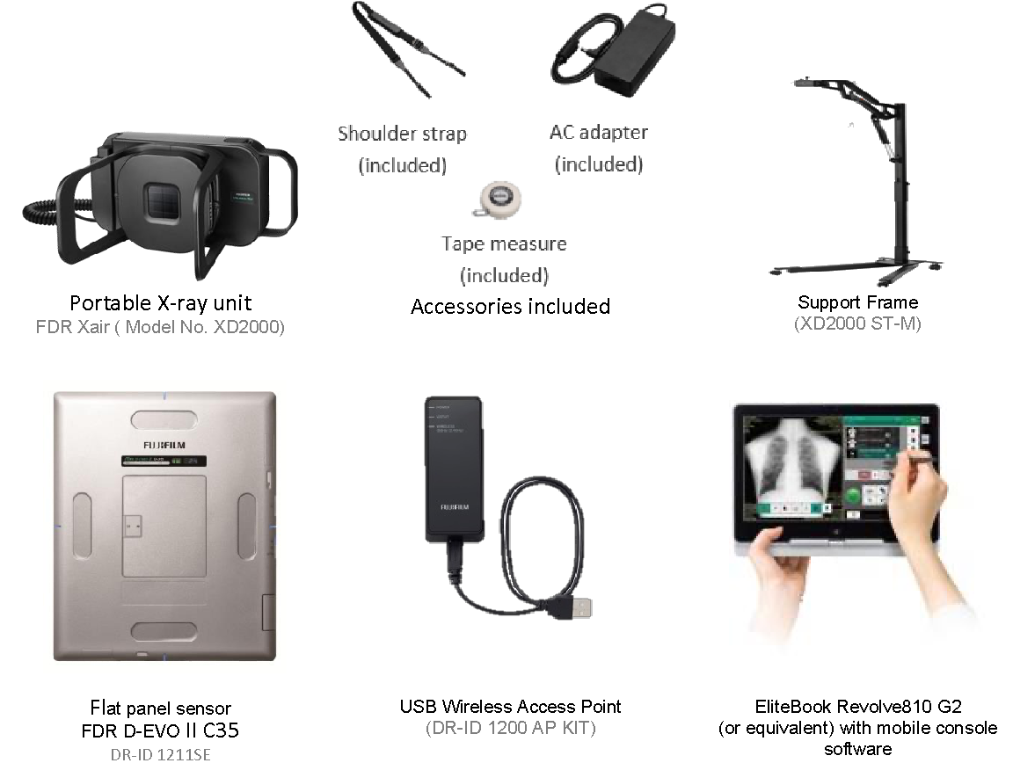

Slide 9
Program Planning -1 - Stakeholder Engagement
To take the services of the local medical officer and medicines for small aliments
Mobilize community for the meetingg
Local Community structures
Oriented about the machine, its advantages, and value addition
Local Health Facilities
NTP
Permission for the Screening camps and allocate space
Local Political institutions
Sensitization to send PTS for the scheduled camp for screening and also support during the camp
Informal Providers
Spreading information about the screening camp and support during the camp (reporting and crowd management)
Govt Frontline Health care workers
Staff
Training & M&E tools
Train on the machine utilization, data reporting and recording

Slide 10
Program Planning –2- Customs Clearance and Local Radiation Authority Approval
No Customs Clearance issues were there as machine was delivered by Fujifilm
Atomic Energy Regulatory Board (AERB) Approval has taken long time
All the Inspections were facilitated by Fujifilm Executives at TBAI site
Two Level process were involved as machines was imported for the first time in India.
It was done virtually as it was during COVID-19 second wave in India
Thermo Luminescent Dosimeter (TLD) was mandatory which took around one month of time for procurement
Approval had taken nearly three months of time

Slide 11
Program Planning –3 - Site Selection & Training
Where ?
Screening Camps were organized at community settings at village administration office, school or government health facility
Why the site ?
TB Vulnerable population sites selected (Industrial, Slum, and old age)
Cross Section of catchment area of 3-4 informal health care providers
Sites where PTS testing was less when compared to Referrals made by the project
Training Overview
Fujifilm Executives trained 4 master trainers of TBAI. Training included on safe handling of the device, Setting up the system, Operating of the machine, handling the consoles and safe packing of the equipment. Master Trainers further trained local field staff (10)

Slide 12
Vendor Selection and Product Cost
Fujifilm FDR Xair XD 2000 Portable X-ray, was requested and approved.
Cost of the machine INR. 37,21,000 (USD. 51,345)
Installable external image processing software 1 Qure.ai. Cost INR. 16,72,969 (USD. 22,969)
Machine has come with one year warranty from the company. We are in the process of renewing the warranty. Warranty cost yet to get the details from vendor
Additionally, accidental insurance to a sum assured of equal to the value of machine INR. 37, 21, 000 (USD. 51,345) was taken. Yearly premium was USD. 602
Thermo Luminescent Dosimeter (TLD),Lead Apron, and Extension boxed were procured. Cost USD.120

Slide 13
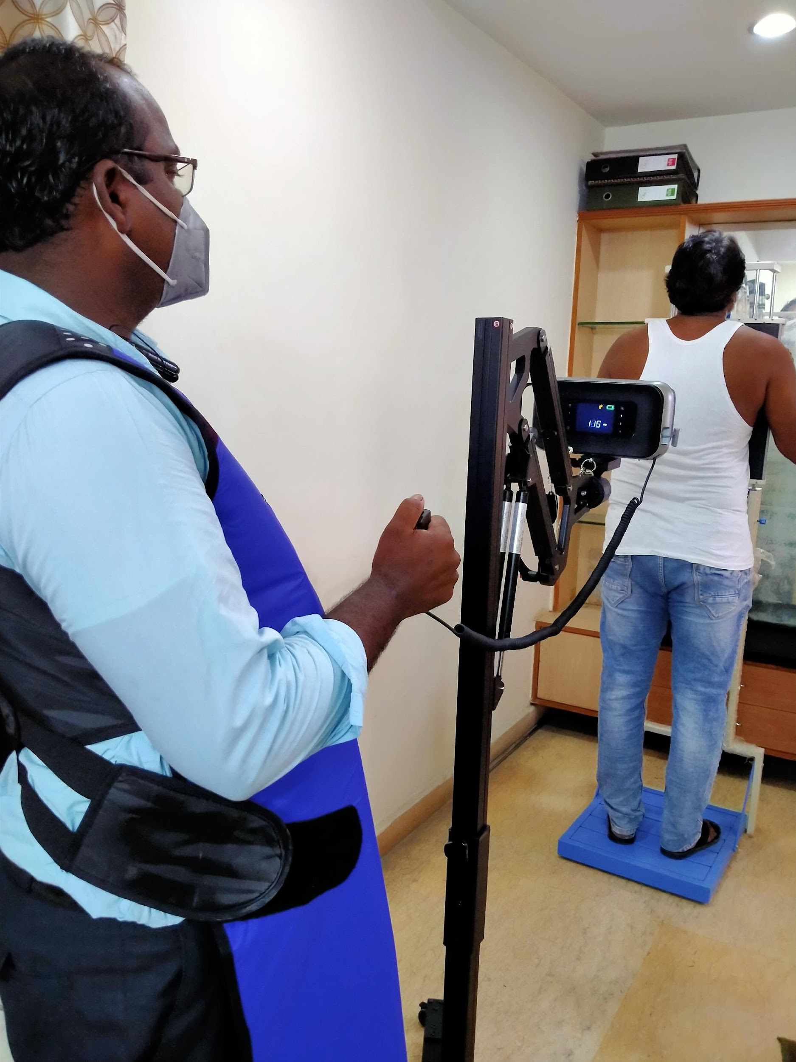
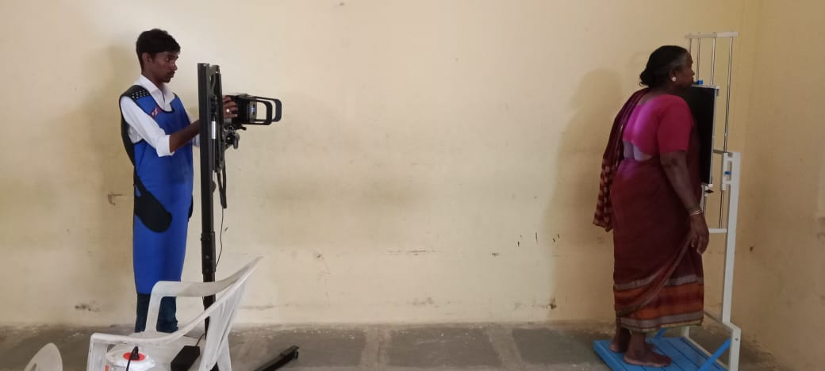
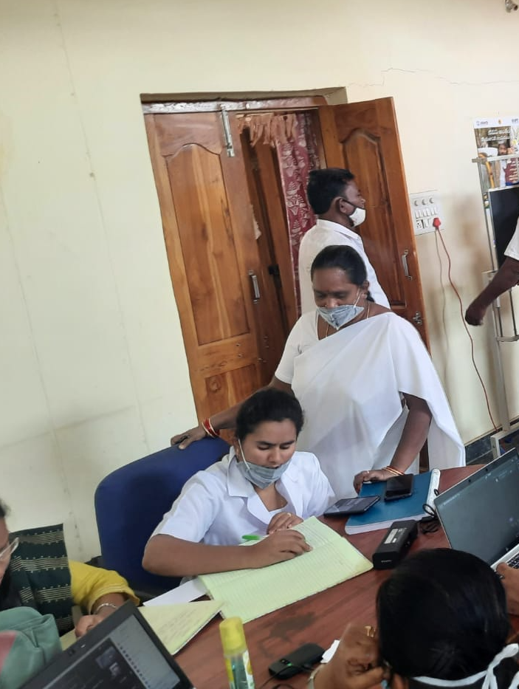
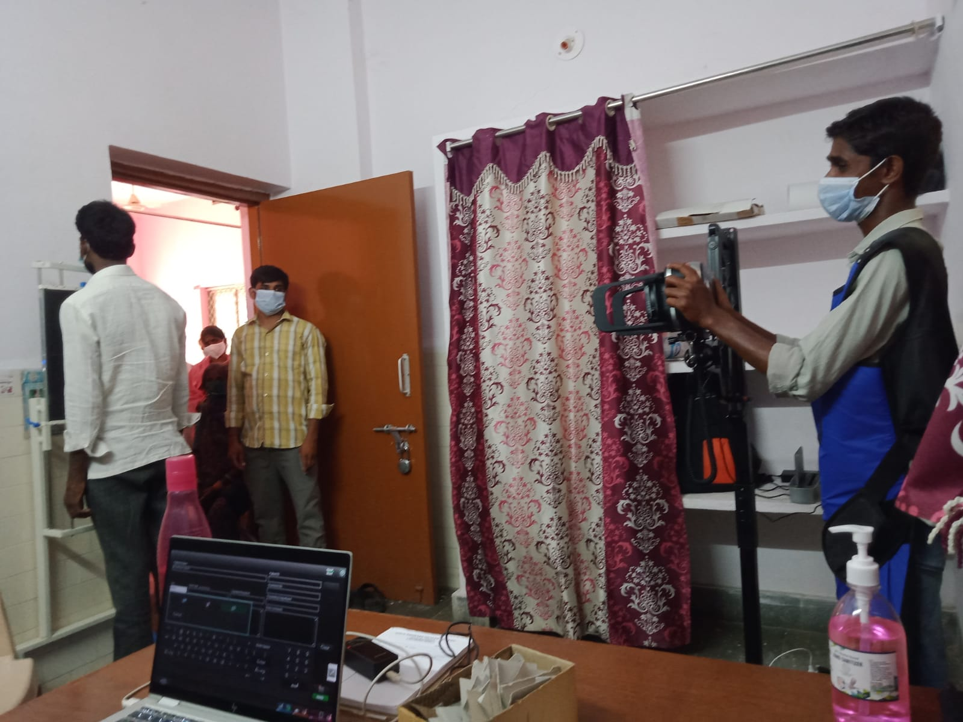
The Set Up

Slide 14
Screening Algorithm-1
PTS with X-ray lesions are counselled about probable TB and prepare for confirmatory tests as per NTP guidelines
Meets ANM or Doctor and shares the health concerns. Brief about the X-ray and purpose of taking it
Awareness about TB by project staff and stakeholders
Que
Registration
Screening of TB
X-ray Screening
Preparing for other tests
NTEP Tests
Demographics, co-morbidities, weight and hypertension checked
Done by Project staff or Local Health staff
Undergoes X-ray, medical officer if present reads the X-ray and X-rays with lesions are separated for counselling
Undergoes as per the NTP algorithm. Project staff help
Notes:
This template was inserted from Power-user, the productivity add-in for PowerPoint, Excel and Word.
Install Power-user to access thousands of templates, icons, maps, diagrams and charts with Power-user.
Visit https://www.powerusersoftwares.com/
©Power-user SAS, terms of license: https://www.powerusersoftwares.com/terms

Slide 15
Screening Algorithm-2
Informed to PTS observed for 15 days /or refer to other department
NTEP testing facility
TrueNaat / CBNAAT
Test
No Symptoms
MTB Not detected
Symptoms persist
MTB detected
Clinically Confirmed by MO
Bacteriologically Confirmed
Treatment Initiated

Slide 16
Operational Set-Up
Screening was done in the Community Setup
Proper Electricity Setup with proper earthing to be ensured
A room with approximate 6 feet between panel and x-ray machine
Avoiding crowd is good but in particle situation it is not possible
Radiation Projection
Person Operating the x-ray camara used to wear Lead apron
Thermo Luminescent Dosimeter (TLD) should be attached to the apron. Quarterly basis TLD device should be sent to AERB to check radiation
Setting up
Initially a bit complex but after some time very convenient
X-rays done under the supervision of trained qualified X-ray technician
CADs was attached through a connector to the laptop console (but not much used)

Slide 17
Ultra-Portable X-ray System Image Quality
“ Excellent Quality of the x-ray, very clear. This Machine does magic “
Radiologist

Slide 18
Results : Machine in action (Aug – Dec 2021)
Conducted 53 camps @ 53 villages of project operational area
The Nikshay, a web based portal of NTP captures the data of presumptive individuals and update the test result, and allot Niksay number (a unique id) for public health action and other follow-ups of the patients
61 Clinically Confirmed and 85 Bact+
23% of PTS tested through NAAT
76% of found suggestive
15% of Screened
14.55% found suggestive of TB using handheld x ray machine
30% found TB diagnosed (All Forms) out of total number of people found suggestive of TB.

Slide 19
Results : Machine in action (After project closure)
8 camps were conducted in Apr and May 2022 in coordination with district NTP manager – to reach industrial workers at their door steps

Slide 20
Data Storage and Privacy
The computer is locked and pass word protected, and it has access to Program Manager only.
Daily back up was taken up in sperate hard drive
While sending the X-rays for radiologist personal identification details are de-identified

Slide 21
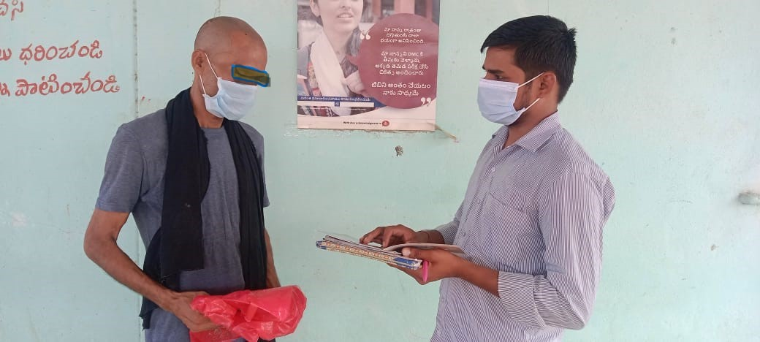
Success Story
“ Lot of my time was saved. I don’t get much leaves in my factory. I went to the X-ray camp in the morning before going to factory. They helped me get tested at Government center next day. Treatment was started with in 2 days. I could manage with only one day leave”
- Industrial Worker Benefited

Slide 22
Experience with the X-ray and CAD vendor(s)
Fujifilm Team was very supportive during the procurement process, training, and also in on ground support
We lost time in getting the machine and also in getting the AERB approvals

Slide 23
Challenges
Completely charged device was supporting on 40 images only. While the average turnover at the camp is some time going to 60 PTS. While device cannot be charged while in use. After 10 minutes charging only one image change be taken. PTS are become restless and going back due to delay.
Machine along with two stands is not handy for a single person to carry. Minimum two persons are required for carrying and using the machine.
A vehicle (four-wheeler) was must and required to carry the entire equipment one place to another place.
Sometimes shortage of testing kits lead in delaying the confirmation and early treatment initiation.

Slide 24
Key Learnings’ and Recommendations
One has to have the preparatory work done well before placing the request for AERB approval, with all the tools/records needed.
A proper orientation and consultation is needed to get the buying from NTP officials.
Though the AI is inbuilt, most of the NTP officials recommended for an expert opinion from Radiologist.
One has to ensure proper logistics like a vehicle to carry the machine as needed in the field, and trained LT on the functionality of the machine, and AI reading to recommend for cascade testing.
Coordination with frontline health staff is desperate as they know the vulnerable and hard to reach community, and mobilize them for X Ray

Slide 25
Thank You !
Vikas Panibatla
vikass@tbalertindia.org
‹#›

