Slide 1


Implementing CAD AI in TB Care- Experiences from Bihar, India
Innovators In Health (India)

Slide 2
Outline
Background
Program planning
Screening algorithm
Deployment
Operational set-up
Threshold score selection
Interoperability with health information systems
Data storage and privacy
Results
Success stories
Scaling up
Experience with the X-ray and CAD vendor
Challenges
Lessons learned
What would you do differently next time?

Slide 3
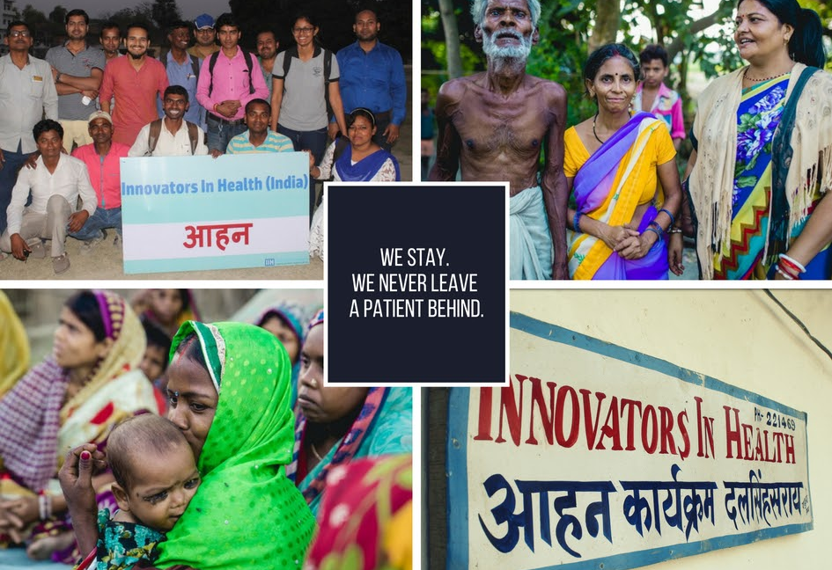
Background
  Innovators In Health is a grassroots non-profit working alongside National TB Elimination Program(NTEP) towards TB elimination since 2010 in Bihar, India.
  Supported by Stop TB Partnership for Wave 5, 5s, Wave 7, and Wave 9
  We implemented qXR by Qure.ai from July 2020 – May 2021

Slide 4
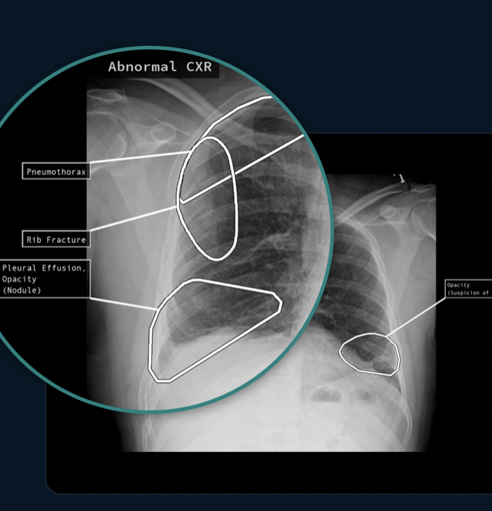
Program planning - vendor selection and product costs
We received a grant of 10,000 scans with our TB Reach Wave 7 proposal. There were no additional procurement costs.
We used qXR – a chest X-ray screening solution built using deep learning. It classifies chest X-rays as TB Negative(normal) or TB Presumptive (abnormal), identifies abnormal findings, and highlights them on the X-ray.
We selected this product as it was clinically validated and was being developed within the country.

Slide 5
Program planning
  Stakeholder engagement
      We got permission from the State TB office prior to project initiation
      Buy-in from District TB centre and physicians at the Primary Health Centre
      Discussion with program staff to ensure proper integration in the screening algorithm
  Training overview
      Introductory call with technicians in the digital X-ray centre
      Program staff and X-ray technicians were trained after deployment
      Physicians were engaged in one on one conversation

Slide 6

Program planning
  Site selection
      A part of TB Reach Wave 7 was focused on case-finding, driven by community health workers. We integrated AI screening within this part.
      The AI solution was deployed across four digital X-ray centres in Samastipur, Bihar. These centres covered the whole program area
      People with TB-like symptoms (presumptive) accessing care in the Public sector were screened by AI

Slide 7
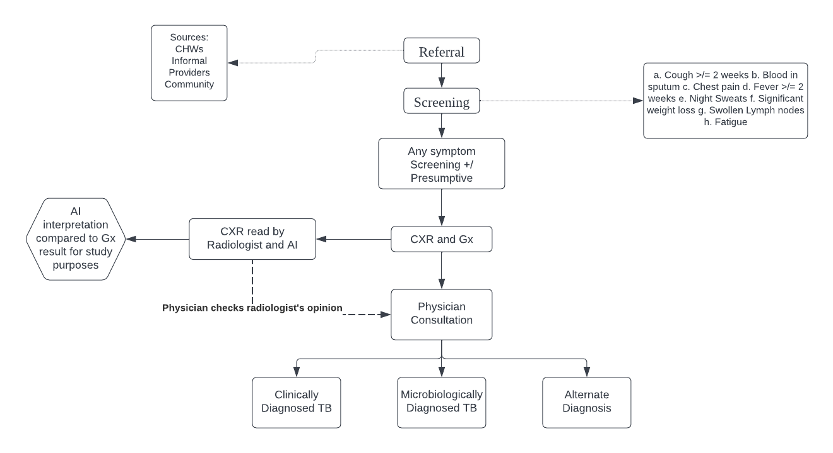
Screening Algorithm

Slide 8

Screening algorithm
CAD used in a validation study format
CAD screening had no impact on patient’s diagnosis
All the X-rays were interpreted by radiologists and CAD
CBNAAT was used as a confirmatory test
Community Health Worker screening patient at doorstep

Slide 9
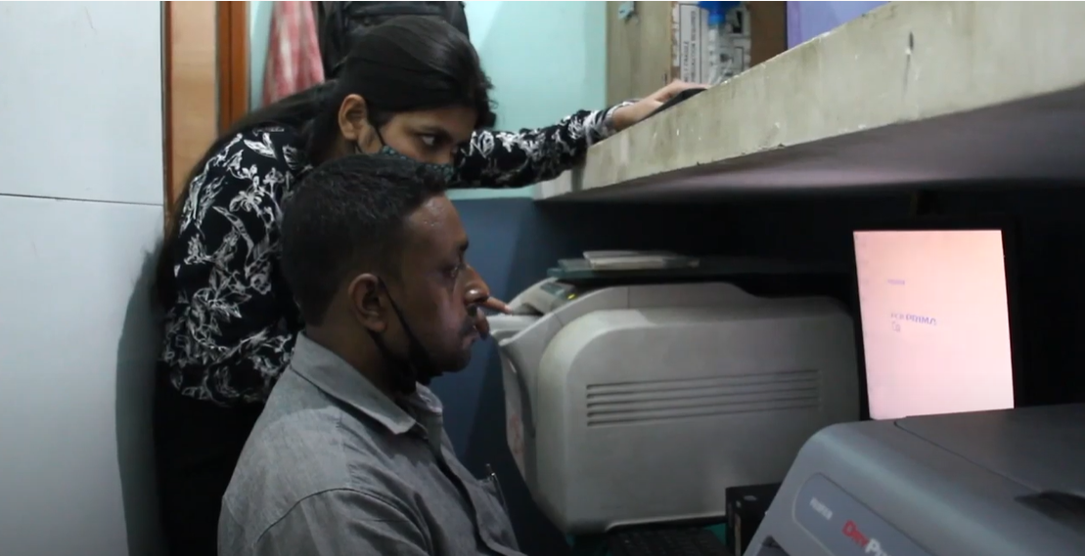
Deployment
Software deployment was planned for one day (3 hours) per site
One resource person from the team on the X-ray site was required and manufacturer’s team deployed it remotely
Two weeks as a testing phase after each deployment and before the next
It took 2 months to complete deployment in all four sites
Multiple challenges to deployment such as COVID, flood and infrastructural issues led to delays
A picture from digital X-ray center during deployment

Slide 10
Operational set-up
A Cloud Based Integration in digital X-ray centers was done
Qure deployed a gateway service on client modality to transfer the chest X-ray DICOM files to Qure cloud.
Gateway continuously monitors for new DICOMS to be processed
A Digital X-ray system where DICOM node could be configured was a requirement
X-rays were manually selected and pushed to Qure cloud. While qXR can integrate with auto-push capability of X-Ray software, it could not be implemented due to infrastructural challenges.
Optimum speed of 8 Mbps speed was advised– necessary for seamless upload of the DICOMS to Cloud and AI analysis and processing. Although, operational set-up was functional at significantly lower speed.

Slide 11
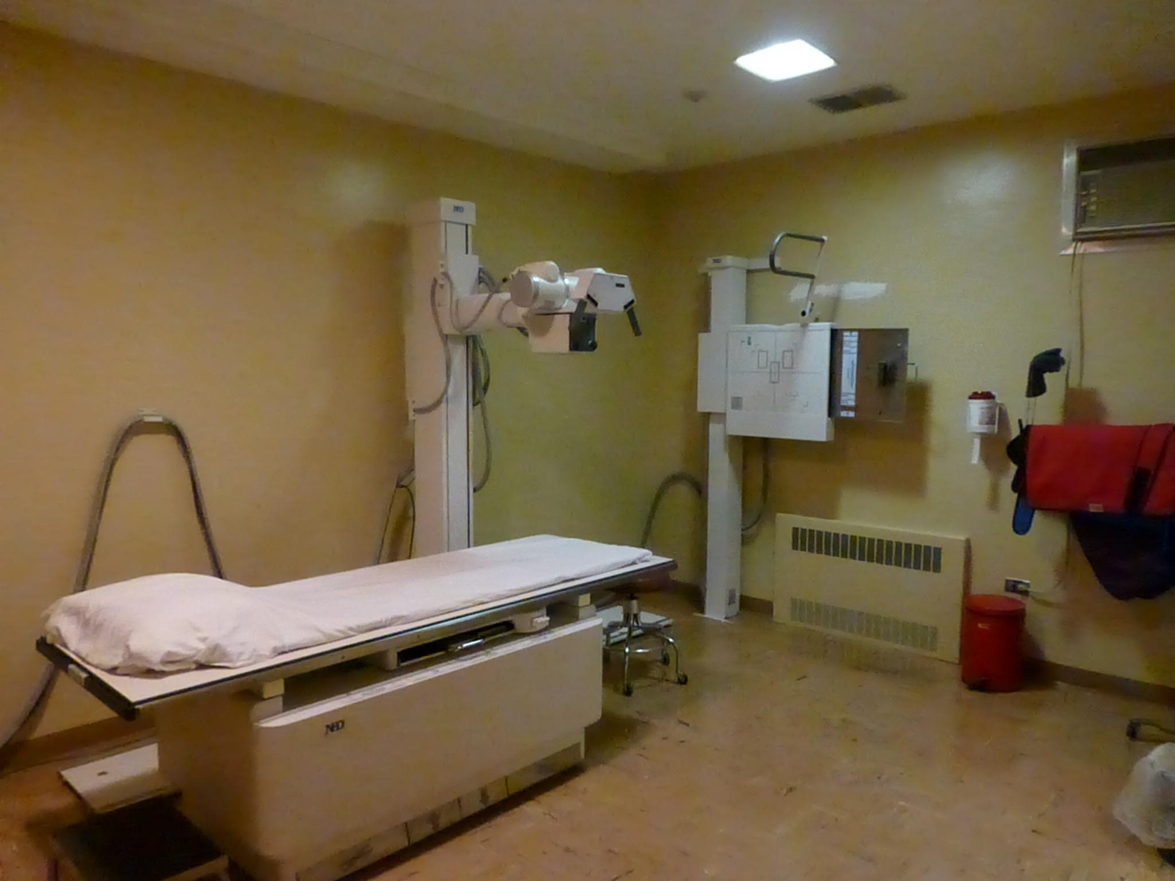
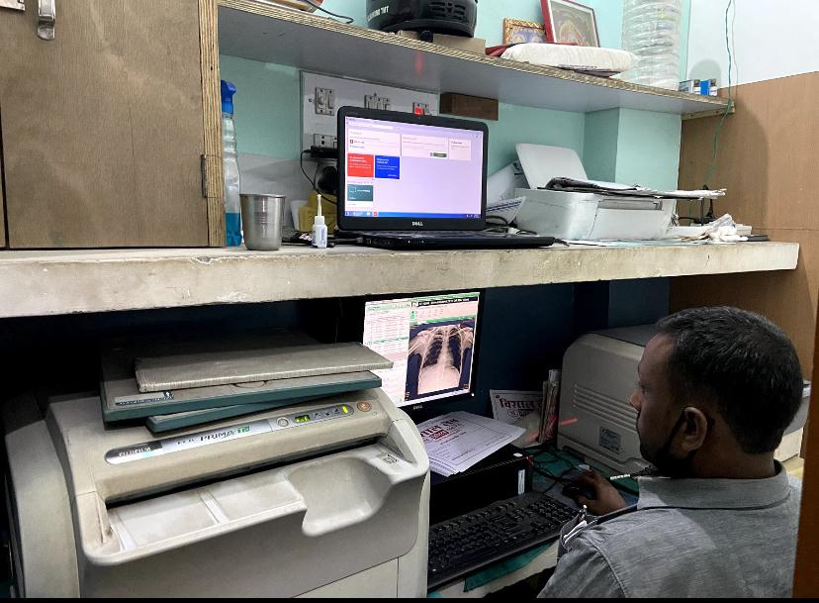
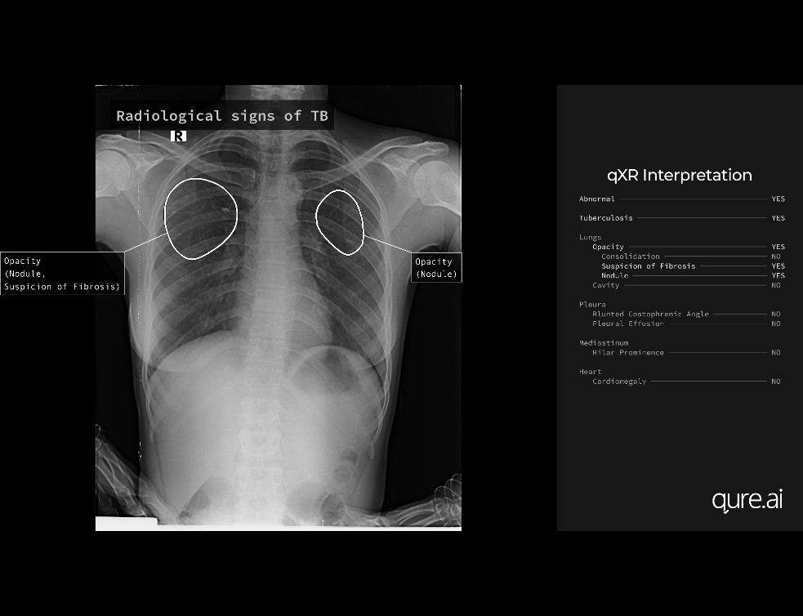
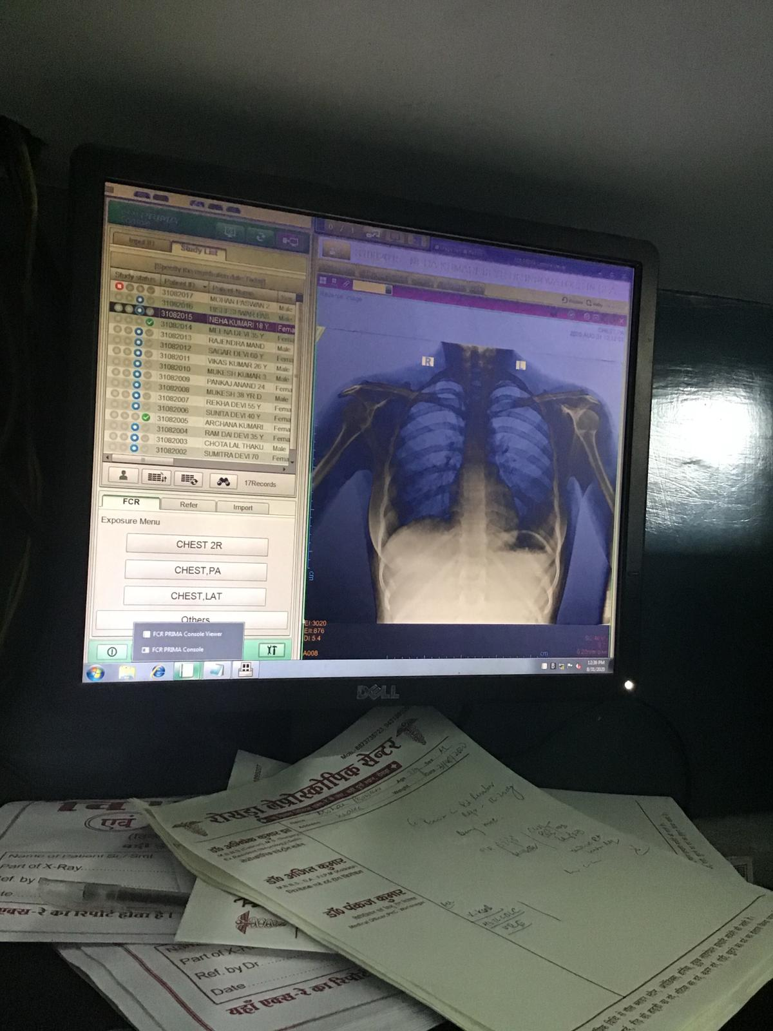
Operational set-up (Process)
Gateway service has to be deployed here
X-ray saved into X-ray center’s modality
Chest X-ray recorded
Technician chooses the relevant X-rays and sends to AI system’s cloud
X-ray interpretation available in the web application

Slide 12


Threshold score selection
What is the threshold score used and how was it selected?
Threshold Score – 0.5
Threshold score was pre-decided by the manufacturer. Qure evaluated threshold score after 2 months of deployment and found 0.5 to be appropriate.
Does this threshold score appear to be suitable so far? (false positives/negatives on CAD?)
We still need to explore this. It would depend on the screening algorithm. A lower threshold might be better suited for programs aiming to maximize case-finding.

Slide 13
Interoperability with health information systems
We work with the public health system that currently doesn’t use EMR
qXR has its platform that could not be integrated with IIH’s data management system
qXR platform had the option to integrate some clinical findings and the CBNAAT report
It had good interoperability with the digital X-ray center

Slide 14
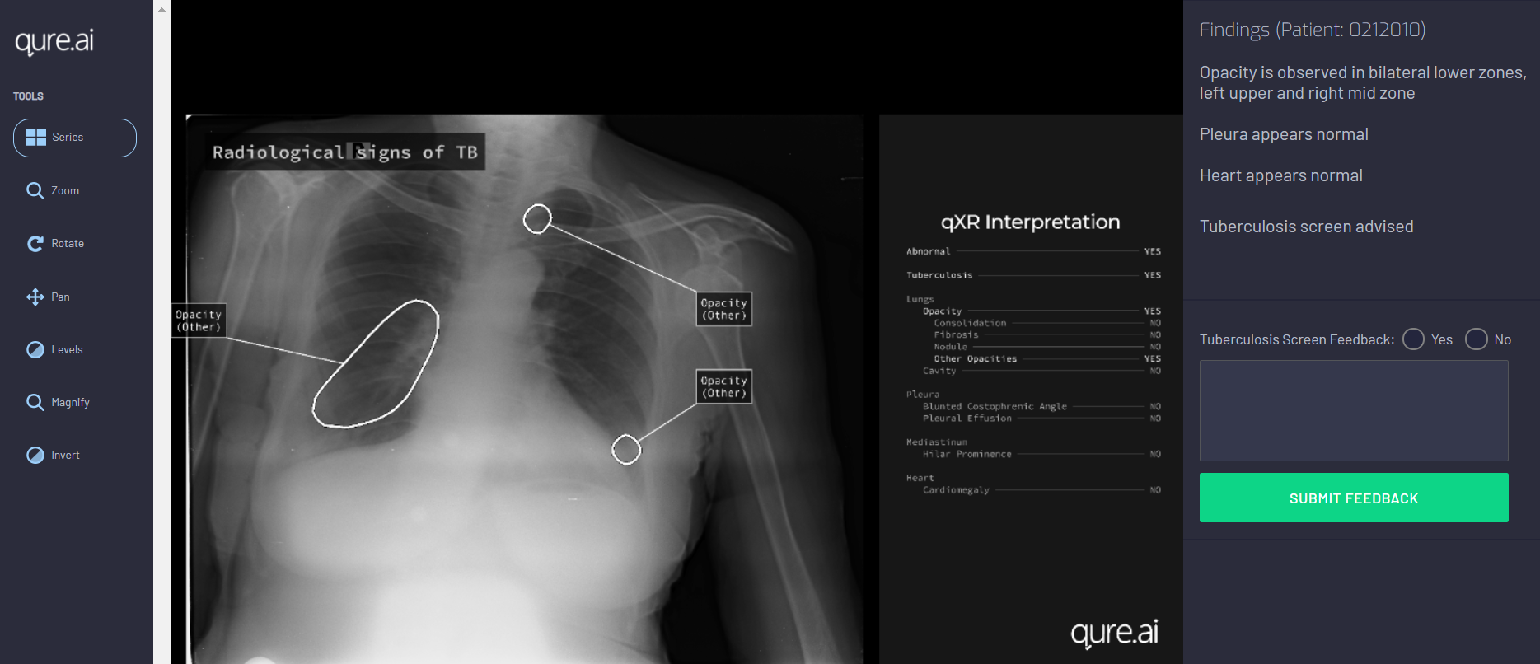
Data storage and privacy
All the data was stored on cloud.
The transfer gateway was a secure network.
Patient data was de-identified before use for purposes other than the patient’s clinical pathway.

Slide 15
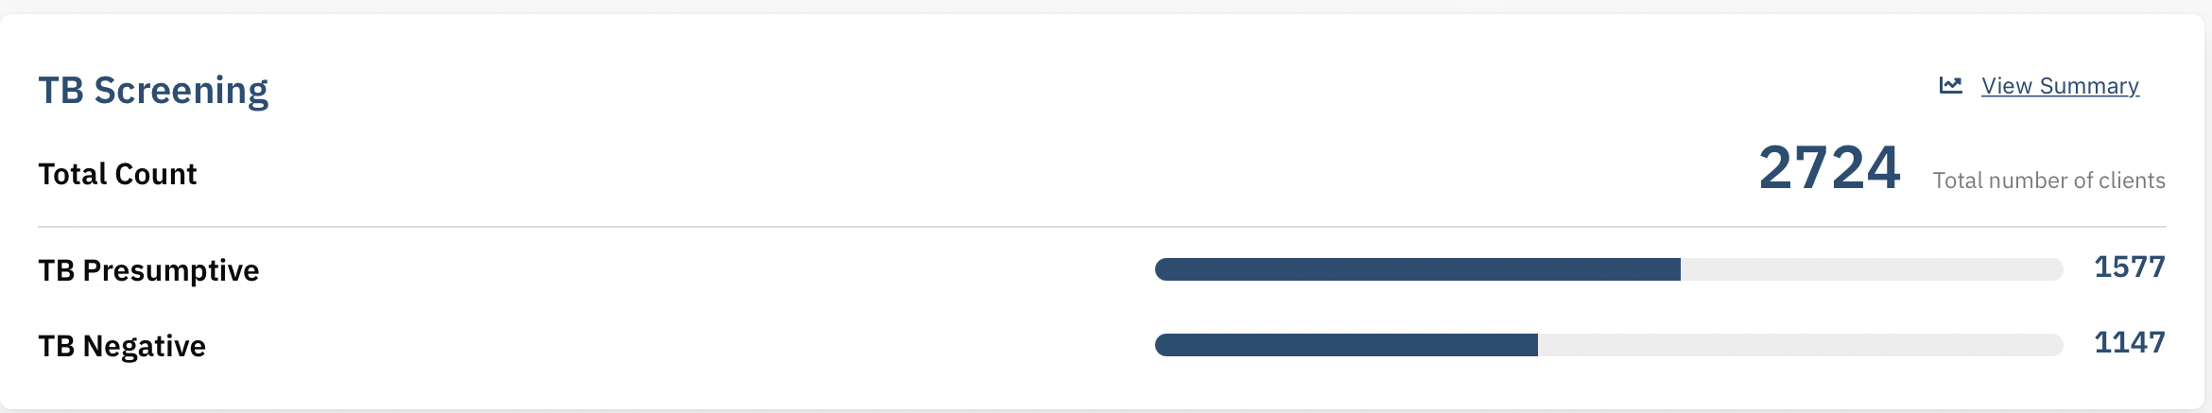
Results

Slide 16
Results : Sensitivity and Specificity compared against diagnosis confirmed by Gx*
 |  | Xpert results
 |  | MTB detected | MTB not detected | Grand Total
QXR | Advised | 227 | 236 | 463
 | Not Advised | 77 | 184 | 261
 | Grand Total | 304 | 420 | 724
 |  | MTB detected | MTB not detected | Grand Total
Radiologist | abnormal | 170 | 137 | 307
 | normal | 120 | 266 | 386
 | Grand Total | 290 | 403 | 693
Sensitivity QXR | 75%
Specificity QXR | 44%
Sensitivity radiologist | 59%
Specificity radiologist | 66%
TB missed QXR | 25%
TB missed radiologist | 41%
PPV QXR | 49%
PPV radiologist | 55%
NPV QXR | 70%
NPV radiologist | 69%
Concordance - 71%
*Some patients were diagnosed clinically by physicians

Slide 17
Scaling up
  We are not scaling up implementation at the moment.
  We hope to dive deeper into the applications of the CAD AI system, learn from other experiences and then move forward

Slide 18
Scaling up
  Experience with Analog film study
qTrack is a mobile application that converts analog CXRs to DICOM images by capturing the CXR film using the phone camera, which is then read by qXR.
Our study used films printed by the digital system.
There is an ongoing validation study to assess the analog algorithm's performance compared the web application

Slide 19
Success
We successfully detected 1577 TB presumptive people and screened a total of ~2700 people
CAD was very helpful as a clinical decision support tool during the pandemic
It was a novel approach that helped us build a new perspective to design future projects
Research study has helped generate valuable learnings that would be beneficial for TB programs

Slide 20
Experience with the X-ray and CAD vendor(s)
CAD vendor (Qure.ai) was supportive and involved throughout the implementation
There was a quick resolution of all the operational challenges.
Product was easy to use and interpret.
Collaborating on research findings

Slide 21



Implementation Challenges
Availability of infrastructure and trained personnel was an issue in remote digital X-ray centers
Low internet speed was a challenge in one of the X-ray centers
Selecting X-rays and sending to the CAD is time consuming if auto push is not feasible and volume is very high.

Slide 22
Lessons learned
1
2
3
4
CAD could act as a passive screening tool if integrated into the health system
Managing multiple X-ray centres was challenging. It’s best to start with one centre
It’s crucial to find the best space for CAD solution in the ongoing program pathway
We should have done a thorough operational research to understand implications of Threshold scores

Slide 23



What would you do differently next time?
Adjust variables to see the performance and best fit of CAD
Engage stakeholders early
Evaluate infrastructure required to support deployment prior to implementation

Slide 24
Thank you!
We look forward to your questions

