Slide 1
Introduction to Computer-Aided Detection (CAD) and Ultra-Portable X-Ray
MODULE 2

Slide 2
INTRODUCTION
This module explores new tools for TB screening: delving into detail on the use of computer-aided detection (CAD) and introducing ultra-portable X-ray (UP-XR) systems. The module also describes how the two systems may be integrated and their individual and combined utility for TB screening and triage.

Slide 3


Course Outline
Understanding, interpreting, and using CAD output
Using CAD in TB screening programs
Product features of CAD4TB
Recap of basic radiology and types of X-ray system
Introduction to ultra-portable X-ray and the Delft Light
How to use CAD and ultra-portable X-ray together
Summary

Slide 4
Learning Objectives
Describe what CAD technology is and how it can be applied in TB screening.
Know the key features of CAD products.
Understand what is meant by “ultra-portable X-ray” and the advantages and disadvantages of using it.
Detail the components and pricing of the Delft Light ultra-portable X-ray system.
Understand the different ways CAD and ultra-portable X-ray can be integrated for use in TB screening and triage.
By the end of this module, participants should be able to:

Slide 5
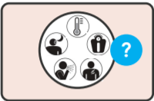
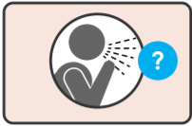
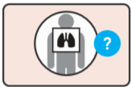
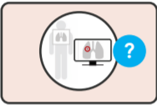

Reminder: WHO Guidelines on Systematic Screening
In general populations without HIV aged 15 years and older in which TB screening is recommended:
Systematic screening for TB disease may be conducted using a symptom screen, chest X-ray with computer-aided detection (CAD) software, or molecular WHO-recommended rapid diagnostic tests, alone or in combination.
CAD software may be used in place of human readers for interpreting digital chest X-rays for screening and triage for TB disease.

Slide 6
Computer-Aided Detection (CAD) Software for Screening and Triage of TB

Slide 7
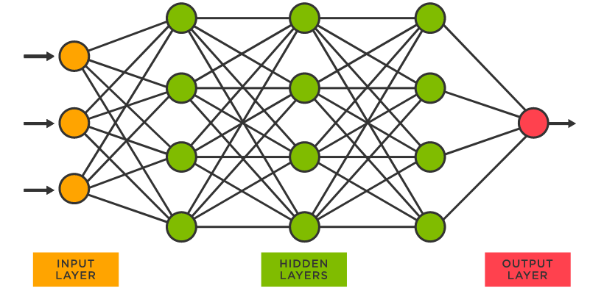
Overview of CAD as a Tool to Screen and Triage TB
Computer-aided detection (CAD) improves the detection of TB by circumventing inefficiencies in the interpretation of chest X-ray (CXR) images, automating and standardizing X-ray interpretation, and supplementing existing human health workers.
CAD uses a type of artificial intelligence known as deep learning neural networks to read chest x-rays and identify signs of TB. Deep learning neural networks take inspiration from the human brain to allow machines to learn to perform specific tasks.
In March 2021, WHO recommended the use of CAD as an alternative to human readers to interpret CXR for screening and triage of TB in individuals aged 15 or over.
CAD is not recommended nor validated for use as a diagnostic tool.

Slide 8
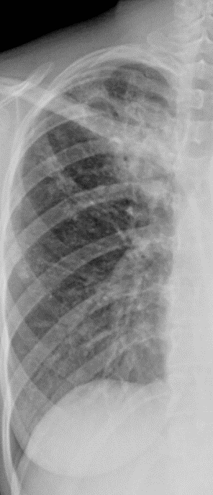
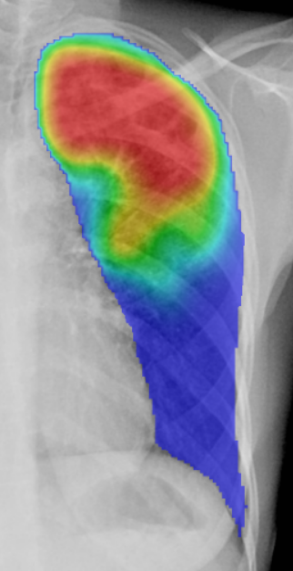
CAD Output
CAD receives digital X-ray or digitized analogue X-ray films and uses artificial intelligence to analyze them for signs of TB. This process can be done with or without an Internet connection.
In general, for each X-ray received, CAD provides:
An abnormality score (between 0–1, or 0–100). High abnormality score = higher likelihood of TB.
A heatmap showing where abnormalities are detected by CAD.
Some CAD products provide a binary classification (“TB-related abnormalities present” or “TB-related abnormalities absent”).
These can be summarized in a customizable report format.
CAD products increasingly also offer a number of add-on features such as data dashboards.

Slide 9
How to Understand the CAD Output
Abnormality score
Binary classification
Abnormality scores are a continuous output (between 0–1 or 0–100) and represent the likelihood of TB being present in a particular X-ray.
However, abnormality scores are not probability and are not standardized across CAD software, so:
An image with a score of 0.4 is not twice as likely to contain TB as an image with a score of 0.2
A score of 0.5 from CAD product A does not mean the same as a score of 0.5 from CAD product B.
Selecting a threshold score translates this continuous output into a binary classification: “Possibility of TB” // “No signs of TB.” All X-ray images higher than the threshold are assigned the “Possibility of TB” classification.
Binary classification
0–44, all images assigned “No signs of TB”
Threshold score = 0.45 (or 45)
45+, all images assigned “Possibility of TB”
0
100
Abnormality score

Slide 10
Detecting Non-TB Abnormalities by CAD
Increasingly, more and more CAD products can function far more like a human radiologist than the simple TB-detecting tools from which they have evolved.
Some TB-CAD software products can classify common CXR abnormalities, such as calcification, cardiomegaly, mass, nodule, and pleural effusion, as well as bone and heart abnormalities.
However, there is a lack of independent evaluation data on the performance of CAD for differential diagnosis and how accurately it localizes abnormalities.

Slide 11
Validation of CAD for Interpreting Digital X-ray
In 2020, the WHO Guidelines Development Group independently evaluated three independent evaluations of three different CAD software for detecting bacteriologically confirmed TB in a range of populations and settings.
The results show the variability of both human readers and CAD software programs across different settings and populations.
Type of case/reader | Sensitivity | Specificity
WHO target product profile | > 0.90 | > 0.70
Screening use case
CAD software | 0.90–0.92 | 0.23–0.66
CXR with human reader | 0.82–0.93 | 0.14–0.63
Triage use case
CAD software | 0.90–0.91 | 0.25–0.79
CXR with human reader | 0.89–0.96 | 0.36–0.63
Conclusion: There is substantial overlap in the sensitivity and specificity of human readers and CAD software, suggesting that there is little difference between the two.
Further:
In many settings, health providers without training in radiology are tasked with interpreting chest X-rays.
These readers may not be as highly skilled as the “gold-standard” readers used for comparison in the evaluations.
So, CAD may perform even more favorably in comparison.
Source: WHO Consolidated Guidelines on Tuberculosis

Slide 12

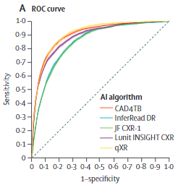
Validation of CAD for Interpreting Digital X-ray
Comparing different CAD products
The performance of different CAD products can be compared by constructing a Receiver Operating Characteristic (ROC) curve and calculating the area under the curve (AUC).
CAD performance ranking from high to low:
In the latest head-to-head comparison of the overall performance of the newest version of five commercial CAD software products, all CAD products:
Significantly outperformed local radiologists
Were able to halve the number of Xpert tests required, while maintaining high sensitivity (>90%)
Performed worse in older age groups and those with a history of TB
CAD product | AUC
qXR | 90.81%
CAD4TB | 90.34%
Lunit INSIGHT CXR | 88.61%
InferRead DR Chest | 84.90%
JF CXR-1 | 84.89%

Slide 13


Where does CAD fit in the TB Screen Algorithm?
CAD can be used with trained human readers as a decision support tool or in place of trained human readers.
Alongside human readers
In place of human readers
WHO recommends CAD to replace human readers in two broad situations in individuals aged 15 and older:
CAD can also work with human readers:
Helping radiologists to optimize their workflow
Alerting human readers to abnormal images requiring prioritization
Providing reporting assistance
Providing quality control
Performing pre-reading assistance
Screening: CAD can be a valuable tool for screening asymptomatic individuals without significant risk factors (e.g., active case finding).
Triage: CAD can be useful in identifying TB in individuals with TB symptoms, risk markers, or other positive test results (e.g., in health care facilities).
The CAD software used must be to the same standard as those evaluated by the WHO Guidelines Development Group.
In either situation, there is insufficient evidence to support the use of CAD with CXR alone for TB diagnosis.

Slide 14
Where does CAD fit in the TB Screen Algorithm?
There are a number of advantages to either technique.
Alongside human readers
In place of human readers
The entire output of CAD, or parts of the output, may be used to inform triage decisions by trained human readers alongside clinical information.
Advantages:
CAD can be used to supplement decision-making, potentially improving on human reader performance.
While human readers’ judgement can be used:
  Where a CAD reading is not conclusive/near the threshold score
  In populations where CAD is not approved (e.g., in children <15 years)
  Alongside CAD for reading X-rays that show a non-TB abnormality
The CAD output may be used by trained non-radiologist personnel to decide the triage outcome. A threshold score is set, and everyone assigned a CAD score higher than this receives confirmatory diagnostic testing.
Advantages:
Increased access to chest X-ray where there is a scarcity of trained human readers or no human readers
May be used to rapidly triage people by non-radiological personnel in high throughput settings
CAD does not become exhausted when reading large quantities of images
No intra- and inter-reader variability

Slide 15
Where is CAD used in the project TB screening algorithm? – for NTP to customize
Suggested information:
  Will CAD be used alongside or instead of human reader?
  Who will receive and review the output?
  What approach will be taken to screening children <15 years?

Slide 16
PRODUCT FEATURES OF CAD4TB

Slide 17

InferRead DR Chest
Latest version: Version 1
Certification: CE marked class IIa
Input
Postero-anterior (PA), antero-posterior (AP) digital chest X-rays
Can be used to read images from any kind of chest X-ray machine
Chest X-ray image format: DICOM, PNG, JPEG
Output
For each X-ray read, InferRead DR Chest provides:
Heat map
Dichotomous output for TB
Abnormality score for TB
Dichotomous output for non-TB abnormalities
Abnormality score for non-TB abnormalities
These are summarized in a structured report.
Deployment
Online, offline, hybrid (offline use with online synchronization)

Slide 18
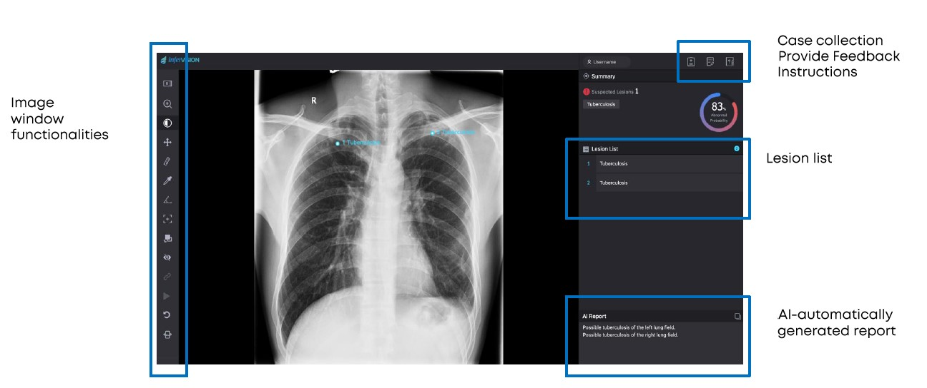
Infervision AI diagnosis system

Slide 19
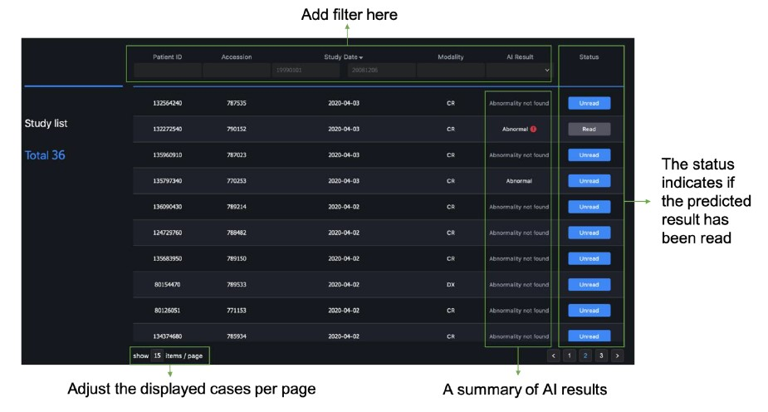
Infervision AI diagnosis system - study list

Slide 20
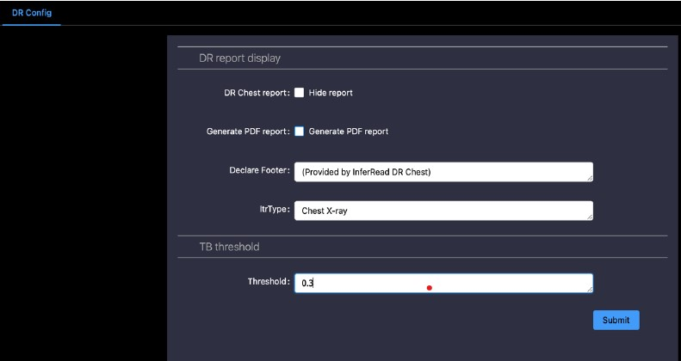
Infervision AI diagnosis system - AI threshold
Adjustable AI threshold settings

Slide 21
Infervision - Package & Pricing
InferRead DR Chest Software (Perpetual License) With unlimited readings for both online and offline use with the dedicated device for offline utilization (CAD laptop). Product maintenance period (Product Support Life Cycle) 10 years, then offline version can be used but online version will cease operation. Data storage / backup: all data can be uploaded to a specific cloud or local server. Auto-clearing function allows users to clear older studies to make space for newer studies. Central server provided by Infervision with no additional cost (500GB or approx. 35,000 CXR images). For every 5 licenses purchased, Infervision provides a free cloud backup server of 1TB (approx. 70,000 CXR images) up to 5 years. Compatibility with X-ray system: not vendor specific. Able to integrate all digital X-ray models generating CXR images according to DICOM format and transmits images via DICOM protocol 1-year of Support and Maintenance is included | $2,700
InferRead DR Chest Laptop Server (Schenker Key 15) 1 x 15.6", Ultra HD OLED, 100% sRGB/DCI- 1x NVIDIA GeForce RTX 2070 Max-Q Refresh, 8 GB GD 1x Intel Core i7-10750H 2 x 8 GB (16 GB) DDR4-3200 Samsung 1 x 1 TB M.2 Samsung 970 EVO Plus, PCIe 3.0 x4, N 1x Intel Wi-Fi 6 AX200, Bluetooth 5.1 1 x Lighted Keyboard US (ISO) Data storage / backup: Embedded 3 Cell Polymer Battery Pack, 73WH, lasting up to 600 minutes (10 hours). Central server provided by Infervision with no additional cost (500GB or approx. 35,000 Chest X-ray images) 2-year warranty included. No country excluded as a final destination This item is mandatory for 'InferRead DR Chest Software' to be operationnal with 'Delft Light Full Kit' | $2,082

Slide 22
Infervision - Package & Pricing
Installation and training Installation guidelines, software operating environment and server configuration Threshold calibration as per protocol and toolkit recommended per WHO 1-hour online training on software usage, administration and utilization to maximum 20 participants, delivered by 2 trainers in English or French . Provision of hard and digital copies of training material for each trainee | $248
InferRead DR Chest support and maintenance extension 1 year Free software upgrade, patches and update conducted remotely. Remote support for issue resolution of reported problem within one working day from the date of reporting. Corrective maintenance as required, hardware to be replaced, shipment to site, disposal of faulty hardware, cost of replacement work, personnel transport and arrangements. One session of 1-hour online training on software usage, administration and utilization to maximum 20 participants delivered by 2 trainers in English or French. Provision of hard and digital copies of training material for each trainee This item can be purchased anytime within the product maintenance / product support life cycle period of 10 years of 'InferRead DR Chest Software Perpetual License' | $232
Additional support and extended 3-year maintenance Free software upgrade, patches and update conducted remotely. Remote support for issue resolution of reported problem within one working day from the date of reporting. Corrective maintenance as required, hardware to be replaced, shipment to site, disposal of faulty hardware, cost of replacement work, personnel transport and arrangements. One session per year of 1-hour online training on software usage, administration and utilization to maximum 20 participants delivered by two 2 trainers in English or French. Provision of hard and one digital copies of training material for each trainee. This item can be purchased anytime within the product maintenance / product support life cycle period of 10 years of 'InferRead DR Chest Software Perpetual License' | $522

Slide 23

CAD4TB
Latest version: Version 7
Certification: CE marked, class IIb
Input
Postero-anterior (PA) digital chest X-rays
Can be used to read images from any kind of chest X-ray machine
Chest X-ray image format: DICOM, PNG, JPEG
Using an app (SNAP4CAD), analog X-ray images can be used as well
Output
For each X-ray read, CAD4TB provides:
Abnormality score for TB
Binary classification “TB” or “Not TB”
Customizable default threshold score: 60
Heat map
For the screening program, CAD4TB provides a full report with screening results. Advanced management dashboard to monitor screening progress also available.
Deployment
Online, offline, hybrid (offline use with online synchronization)
PACS: CAD4TB is a mini PACS system that can store up to 30,000 x-ray images.
If the user has their own PACS system, CAD4TB output (score, report and heat map) can be send to the PACS system.

Slide 24
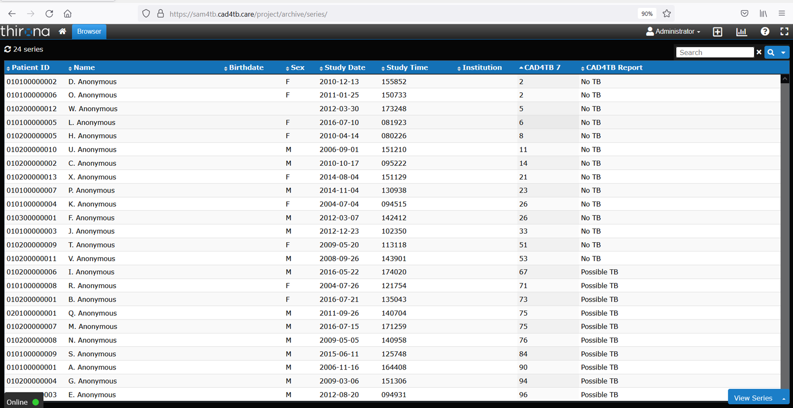
Screening register in CAD4TB system
Notes:
The columns indicate:
the patient ID automatically assigned by the CAD4TB system
the patient name as registered
the patient birthdate as registered
the patient sex as registered
the date of the X-ray
the time of the X-ray
the site of the X-ray
the score allocated by CAD
the classification allocated by CAD

Slide 25
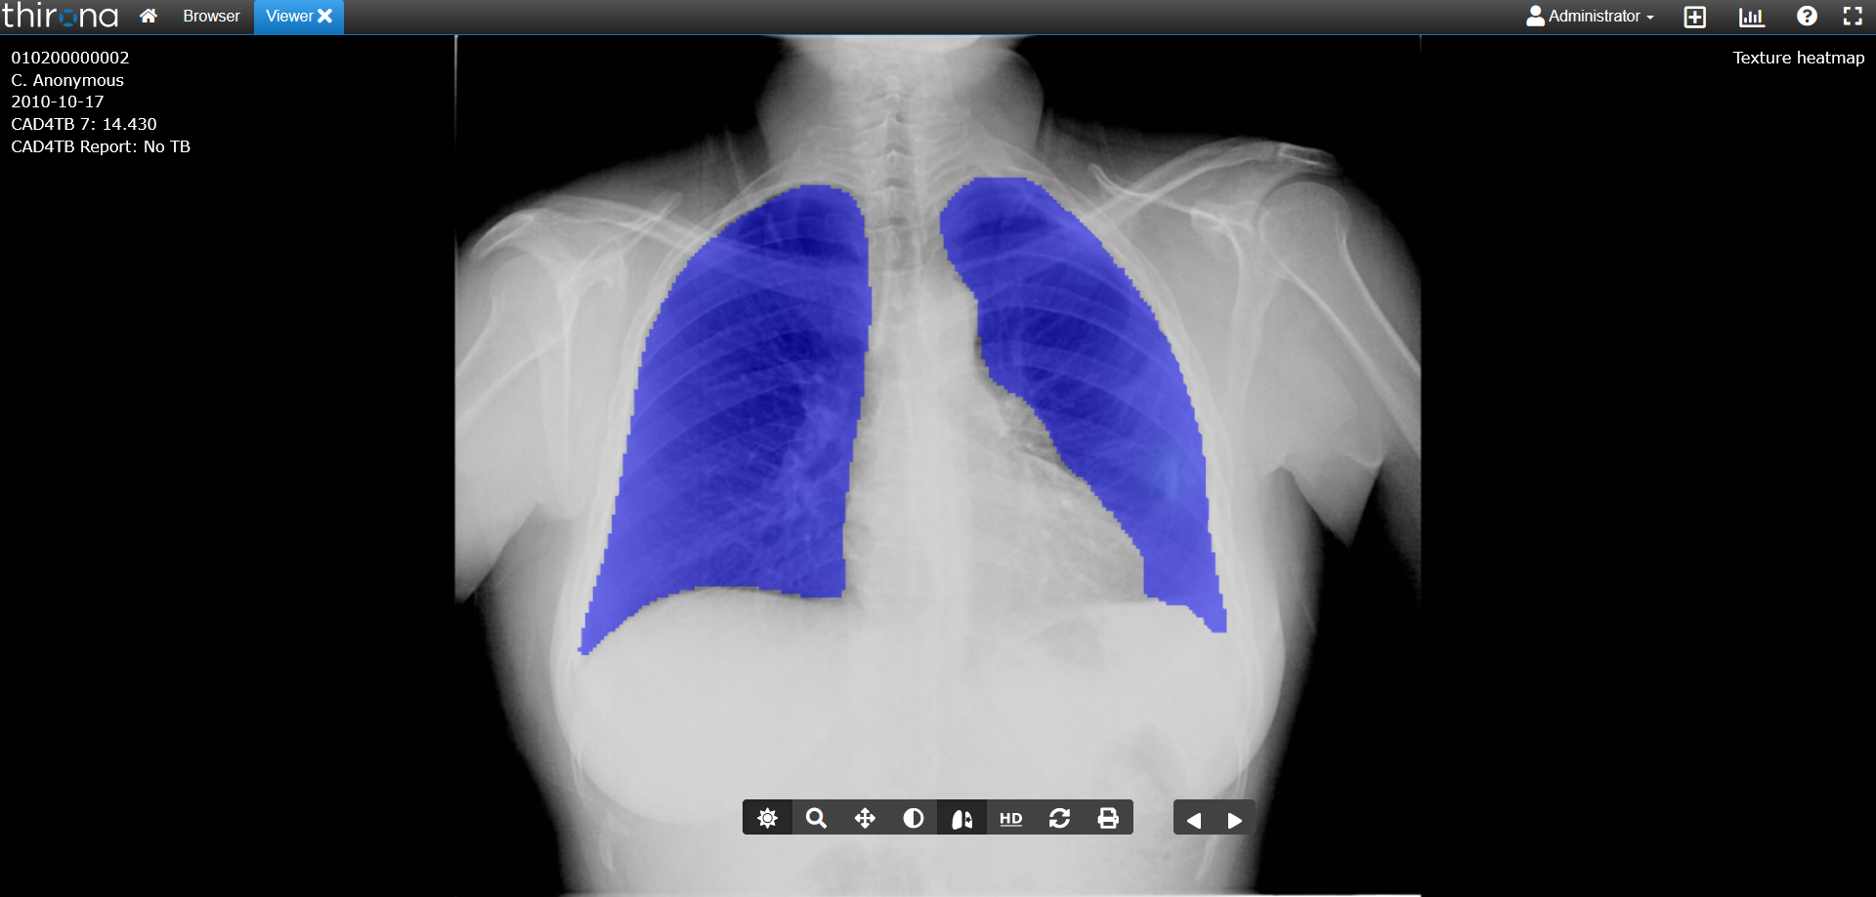
CAD4TB viewer window showing heatmap and score- no TB
  Heatmap
Abnormality score and dichotomous classification

Slide 26
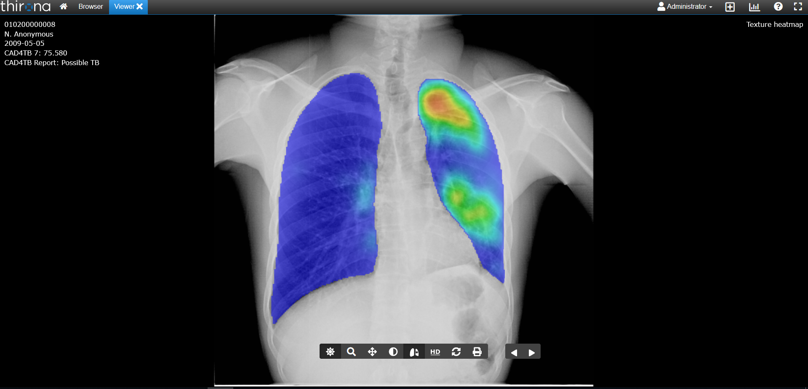
CAD4TB viewer window showing heatmap and score- possible TB
  Heatmap indicating TB
Abnormality score and dichotomous classification

Slide 27
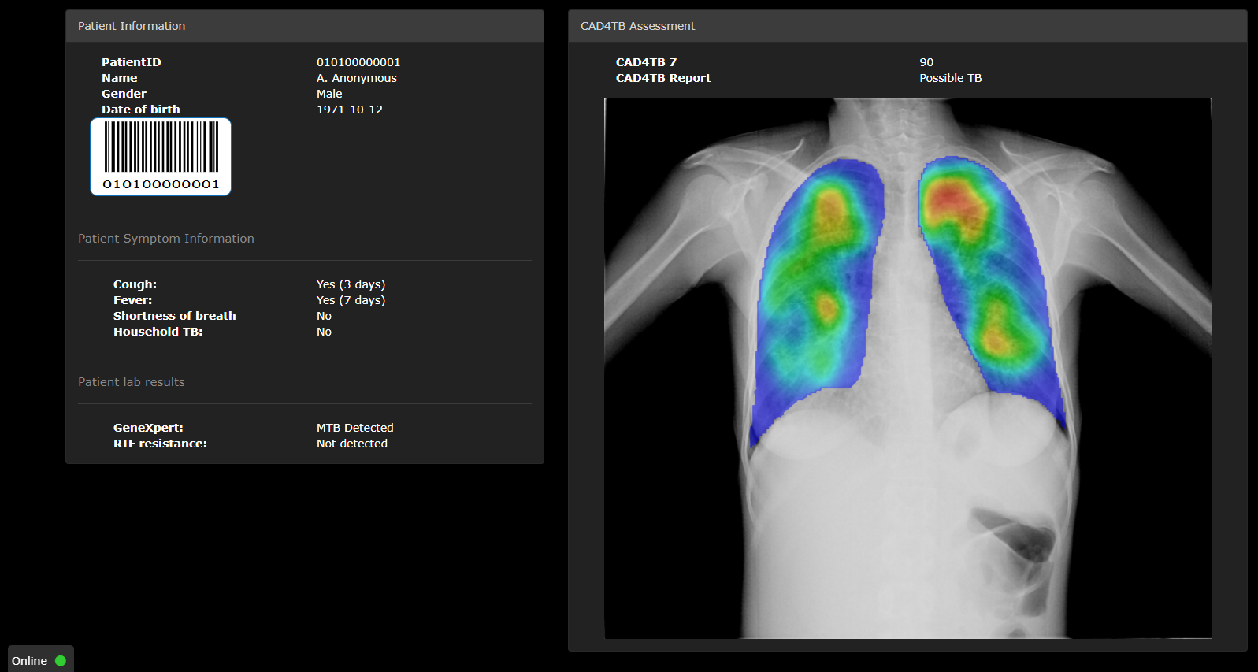
CAD4TB symptom and GXP report

Slide 28
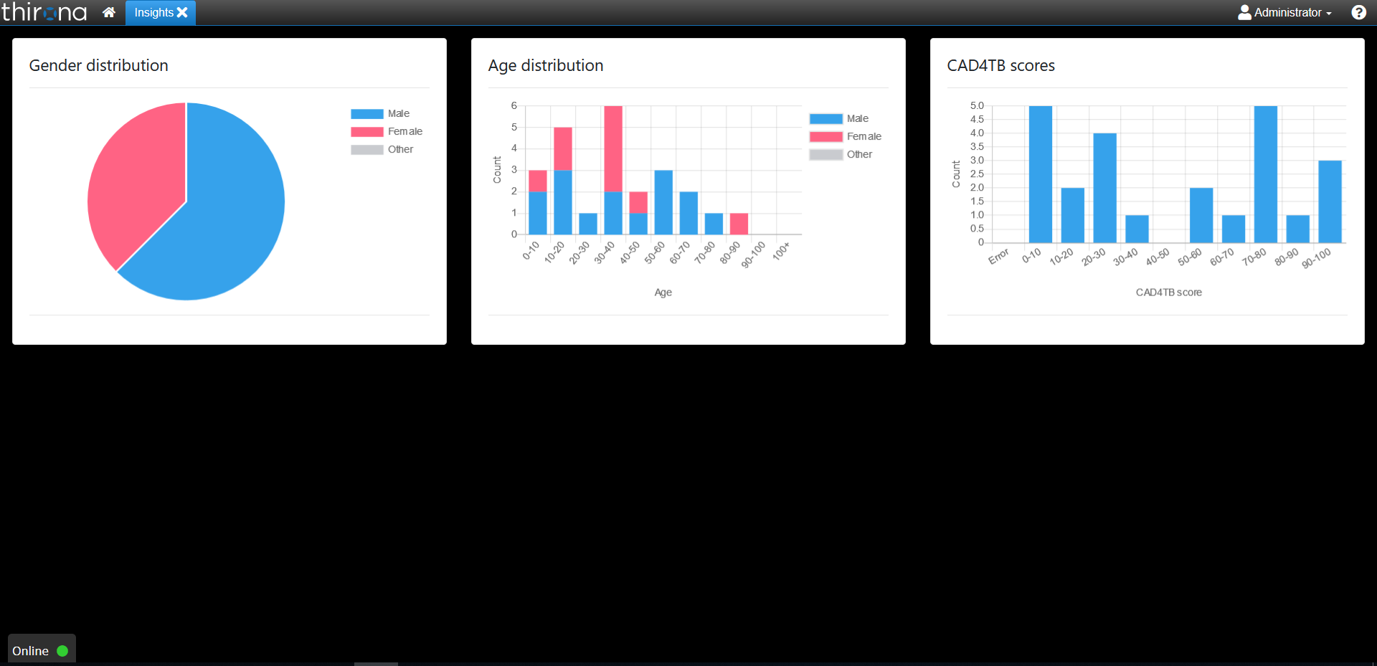
CAD4TB insights module showing gender, age and score distribution

Slide 29
CAD4TB V7 Package and Price
One CAD4TB software perpetual license with 12-month support and maintenance Five viewing licenses (five additional computers can view images on the CAD4TB server) The client can choose: Where to store X-rays: on local server, local cloud, or supplier’s server. Up to 300 images per license per day can be stored on Delft server (using Amazon Web Services). To automatically de-identify data One year of support and maintenance, starting on the day of successful installation and user acceptance | $12,750
One CAD4TB box + 10” tablet Storage capacity approx. 20,000 images Supplied with a USB disk (1TB) for offline backup One-year warranty, starting on the day of successful installation and user acceptance Total warranty period cannot exceed four years from the day of initial successful user acceptance | $2,750
A volume-based pricing discount when procuring multiple CAD4TB perpetual licenses
Number of CAD4TB perpetual licenses purchased | Price (per license) in USD
1–9 | 12,750.00
10–19 | 11,475.00
20–49 | 10,837.50
50+ | 10,200.00

Slide 30
CAD4TB V7 Package and Price
Installation and training Software operating environment and server configuration Installation (software and hardware) and Threshold score calibration study in the setting of intended use based on WHO protocol and toolkit | $1,150
One-year extension of support and maintenance Free software patches, upgrades, and update Remote support for issue resolution within one working day from the date of reporting Corrective maintenance Covering replacement hardware, shipment to site, disposal of faulty hardware, cost of replacement work, personnel transport, and arrangements One-day remote theoretical and practical training of up to 10 operators Hard and digital copies of training materials for each trainee Access to Delft eLearning online platform for each trainee Note:Should be procured at the time of procuring one CAD4TB software perpetual license or one CAD4TB box or while the initial warranty period of item to be covered is still running. It extends the initial warranty period of one CAD4TB system (license and box) for 12 months. | $5,100
Three-year extension of support and maintenance | $11,475
Notes:
Discount

Slide 31
RECAP ON BASIC RADIOLOGY

Slide 32
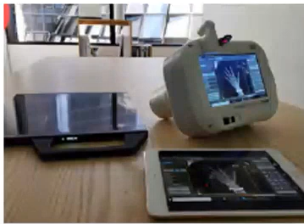
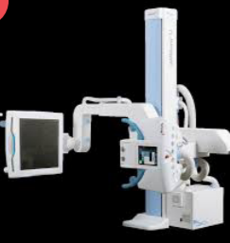
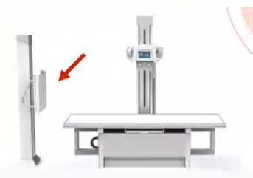
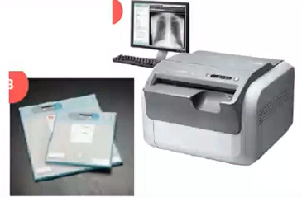
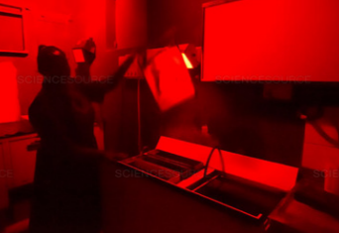
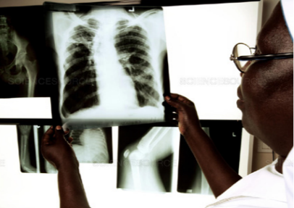
Types of X-ray Technology
Digital radiography (DR)
Retrofit and computed radiography (CR)
Analog radiography
Digital generator and detector package
Existing analog generator and digital detector or CR reader
Analog generator and manual image processing
Latest development in X-ray technology
Image receptor: Solid state detector
Automatic image processing using provided software
Digital output (DICOM, JPEG)
Integration with PACS possible due to digital image format
Reading by CAD is automatic
High image quality and better radiation dose efficiency
Portable systems available
Rapid image generation
Image receptor: New digital detector (retrofit) or digitizer/CR reader (CR)
Image processing can be automatic using software (retrofit) or need digitization using CR reader (CR)
Output is digital (DICOM,JPEG)
Integration with PACS possible due to digital image format
Reading by CAD only possible after digitization
Lower radiation dose efficiency than DR systems
Traditional method of X-ray imaging
Image receptor: Analog film
Wet processing using trained human resources to generate final image
Need trained human reader to interpret film, difficult to use in the field
Output is the X-ray film
Integration with PACS not possible
Reading by CAD only possible after digitization
Lower throughput possible due to complex image processing
Poor radiation dose efficiency
Notes:
Types of x-ray technology

Slide 33
INTRODUCING ULTRA-PORTABLE X-RAY

Slide 34

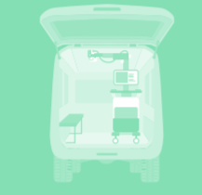

Introducing Ultra-portable X-ray (UP-XR)
Advantages of UP-XR:
De-centralize X-ray screening and expand access
Built in battery operated
Low weight—reduced physical strain on staff carrying or setting up the system
Reduced radiation exposure
Image quality reportedly comparable to stationary X-ray
Types of radiographic systems:
Disadvantages of UP-XR:
Limited battery life when operating devices without connection to electrical mains
Low to medium throughput
More portable detector and generator stands may be more manual to operate
Stationary:
High workload, stable electricity, general radiology, delivers high image quality
Mobile:
Moderate workload, intermittent power supply, can be moved/rolled around, high image quality
Ultra-portable:
Low to moderate workload, battery powered, acceptable image quality, low radiation, field friendly

Slide 35
FUJIFILM XAIR

Slide 36
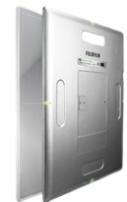
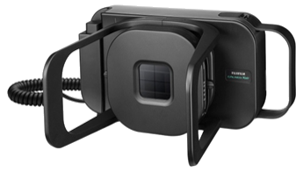
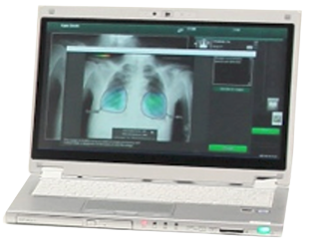
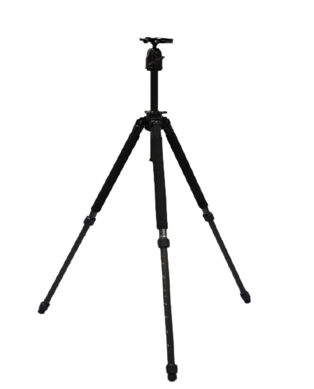
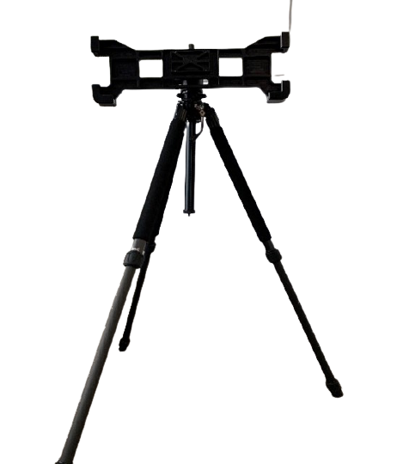
The core system consists of an ultra-lightweight X-ray generator (FDR Xair XD2000), wireless FDR X-ray detector (FDR D-EVO II) and HP Console Advance (DR-ID 300CL).
Core System
CE-marked for Medical Device Systems and Procedure Packs
The generator, detector, and console all have built-in Li-ion batteries, allowing use in the field without electricity for limited periods of time.
The generator is provided with a handswitch to allow the remote operation of the system from a distance of 2.5 meters.
Light-weight and collapsible generator stand with vertical adjustment from 38-164 cm and capable of 90 degree rotation.
Light-weight and collapsible detector stand that can support the detector both vertically and horizontally.
The Console Advance has image processing and manipulation software installed and also provides the link to CAD4TB.
Detector
Generator
Console Advance
Generator stand
Detector stand

Slide 37
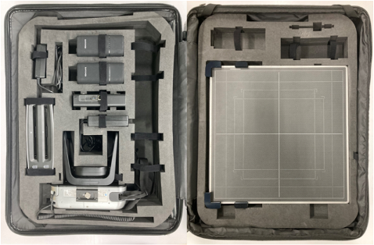
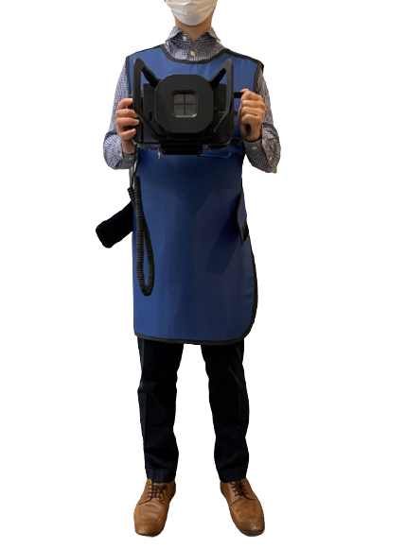
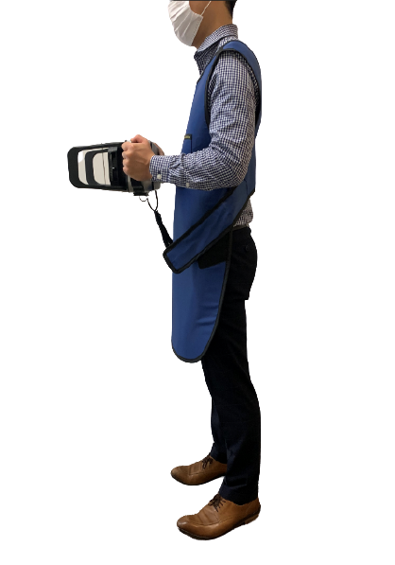
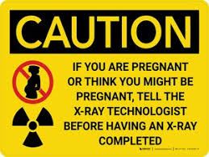


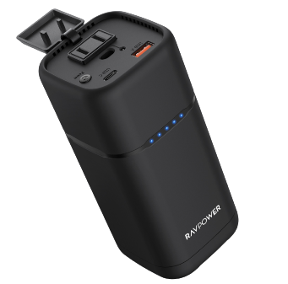
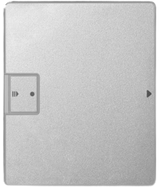
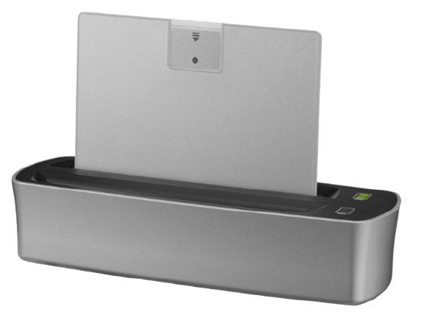
Accessories
Alongside the core system, accessory equipment is provided to ensure the smooth and safe operation of the system in the field, including;
Carrying case, which is able to transport all Fujifilm Xair system components and can be carried on a mini carry cart.
Radiation protection equipment
Including 1 protective lead apron, 10 shock detection stickers, and at least 1 water-resistant, durable and portable radiation warning signs, mentioning radiation hazard and pregnancy
Supplementary and external power sources
Replacement detector battery and charger is provided with the system so the detector battery can be exchanged to extend field operations.
FDR Xair power bank to recharge all electrical components in screening situations without access to electricity.
Carrying case
Radiation protection equipment
Radiation hazard signs
Lead apron
Shock stickers
Supplementary and external power sources
Exchangeable generator and detector batteries with battery charger
Power bank

Slide 38
Fujifilm Xair Full Kit—Pricing
From the GDF catalog, the price of the Fujifilm Xair full kit is $47,000.
The full kit includes:
Component | Weight (kg)
X-ray generator | 3.5
X-ray generator stand | 1.7
X-ray detector (incl. batteries) | 3.4
X-ray detector stand | 3.0
Console advance laptop | 1.25
Lead apron | 4.9
Battery charger (s) | 0.5
Power bank | 0.67
Carrying case | 10
AC adaptor | 0.51
Total | 29.4
The full kit should be purchased with Installation and Training costing $2,000,

Slide 39
Fujifilm Xair Full Kit—Pricing
Warranty
One-year warranty is included starting on the day of successful installation and user acceptance. Includes:
Visits for preventive and corrective maintenance, including the provision of a maintenance report
Software patches, upgrades, and updates
Helpdesk 24/7 availability for service calls, ensuring an issue resolution within five working days maximum from the date of issue reporting
Replacement/repair of faulty components (excluding batteries), including associated transport costs
One session of theoretical and practical training
Installation and training
One session of theoretical and practical training of up to 6 operators on safety, use, transportation, and maintenance per instrument (En/Fr)
Provision of hard and digital copies of training materials.
Installation performed at the same time as training
Warranty extension
One-year extension: $5,000
Three-year extension: $15,000
Warranty extension should be procured when purchasing the Fujifilm full kit or while the initial warranty period is still running.
Max 50 years

Slide 40
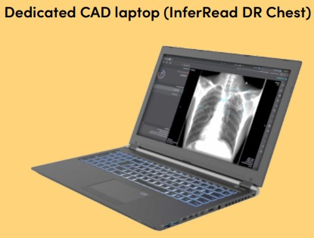
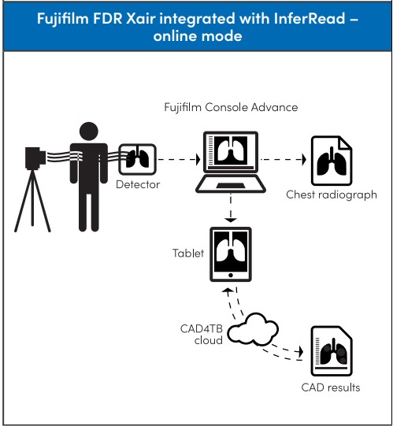
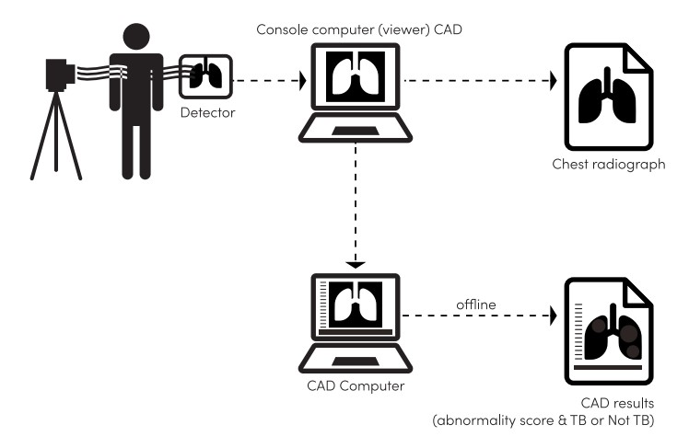
Connection with Infervision
Online
Fujifilm FDR Xair, another device (laptop or tablet) is needed in addition to the Fujifilm Console Advance in order to access the CAD cloud server
Offline
Infervisions dedicated CAD Laptop as show in the image is required when combined with Fujifilm FDR Xair in order to access the CAD cloud server
Hybrid
Hybrid setup uses the offline equipment configuration but with pre-configured synchronization of data to a server when the Internet connection is restored after periods of operating offline.

Slide 41
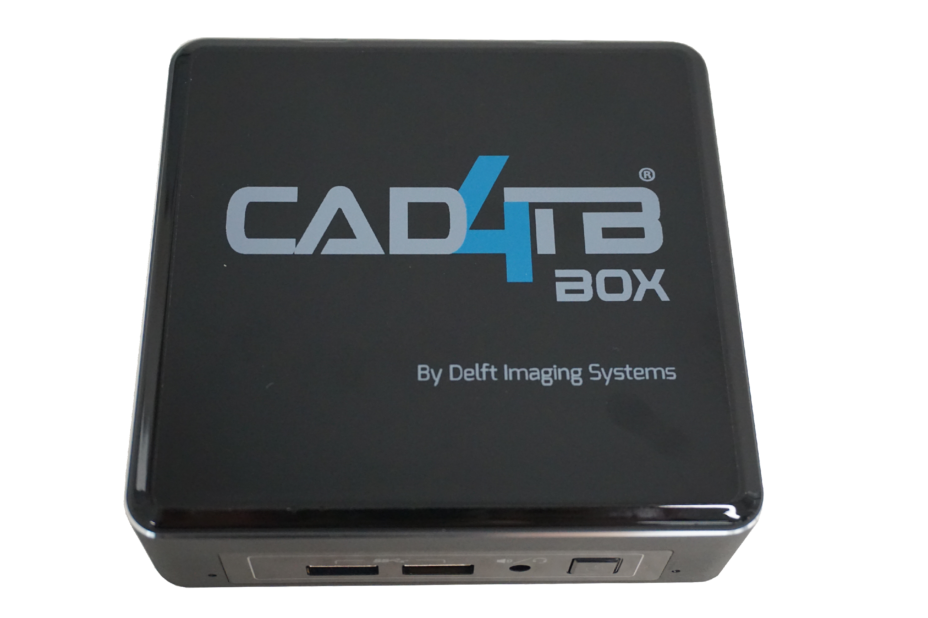
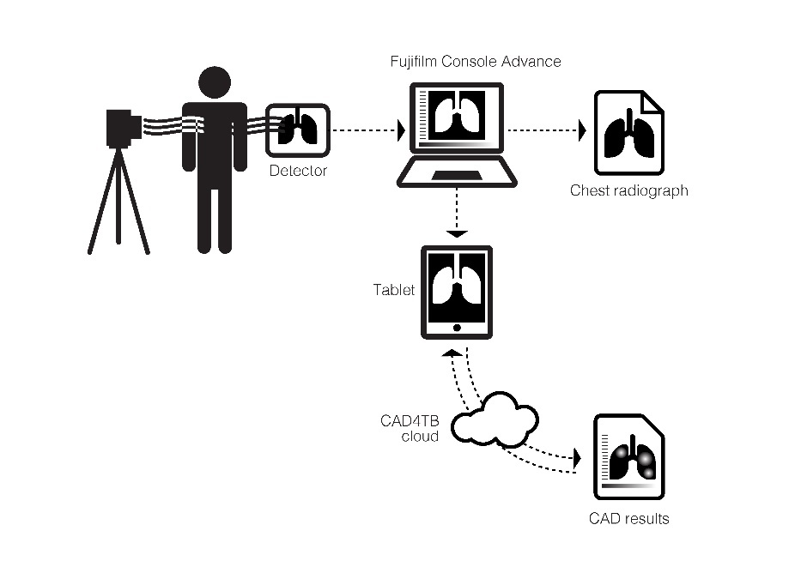
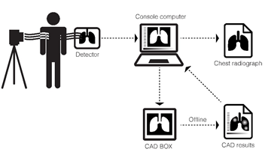
Connection with CAD4TB
Online
The Fujifilm Xair Console Advance receives CXR images from the detector and sends them to the provided CAD4TB tablet.
The CAD4TB tablet then sends them to the CAD4TB cloud containing the artificial intelligence.
Results from CAD4TB are shown on the CAD4TB web platform, accessed from Internet browsers on the tablet.
Offline
The CADTB box (pictured) containing the artificial intelligence is connected to the Fujifilm console advance laptop and analyzes the CXRs it receives from the laptop.
Results from CAD4TB are shown on the console laptop.
Hybrid
Hybrid setup uses the offline equipment configuration but with pre-configured synchronization of data to a server when the Internet connection is restored after periods of operating offline.

Slide 42
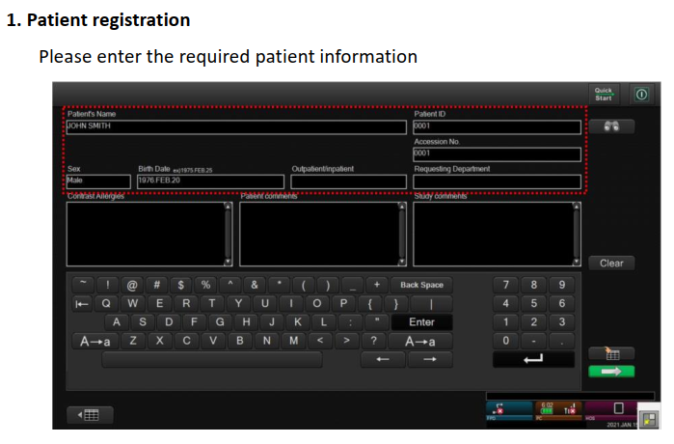
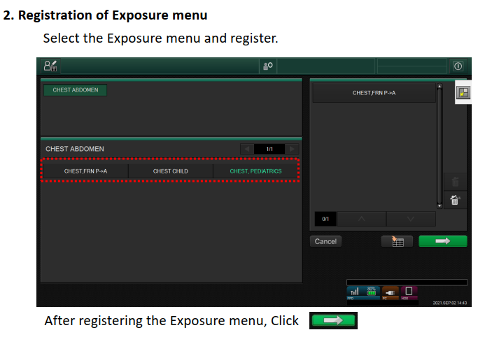
Console Advance CAD4TB Inter-Communication

Slide 43
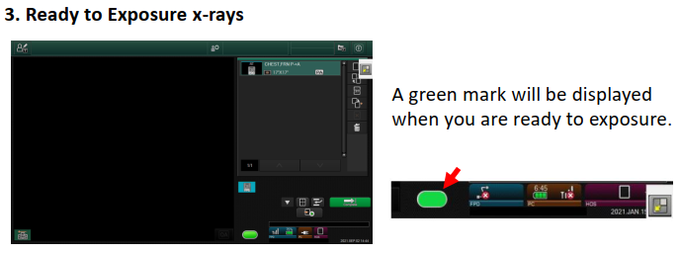
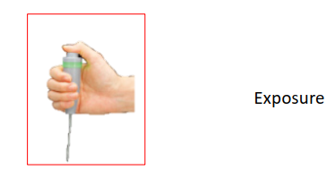
Console Advance CAD4TB Inter-Communication

Slide 44

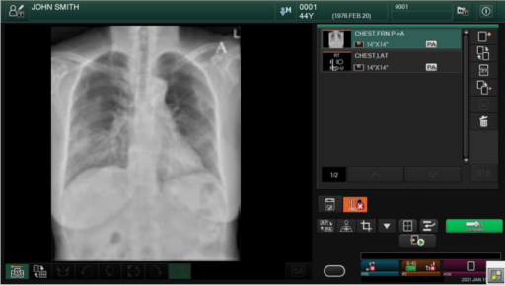
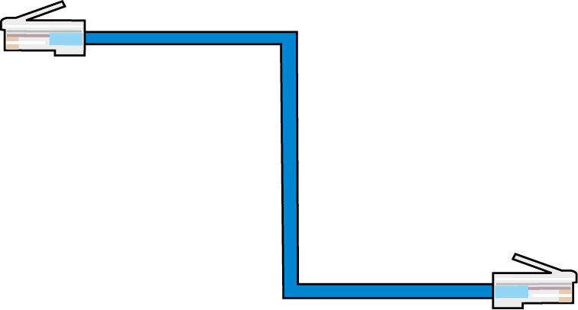
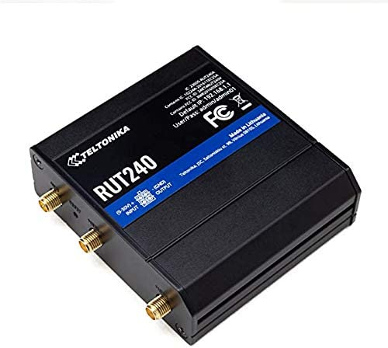

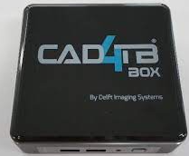
Console Advance CAD4TB Inter-Communication
Console Advance
Connect wit LAN Cable
CAD4TB router
Connect wit LAN Cable
The X-ray image is displayed on the console.
Click to complete and the image will be transferred automatically.
Transfer the image to CAD4TB system.
CAD4TB box

Slide 45
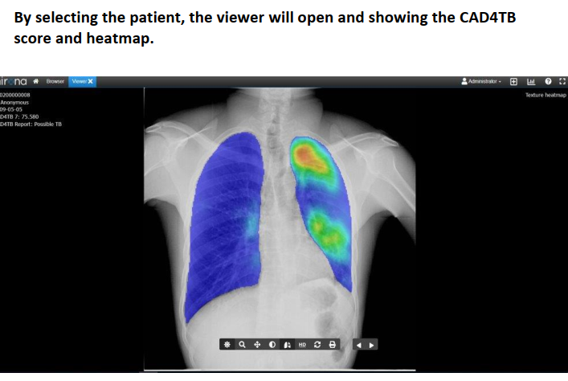

Console Advance CAD4TB Inter-Communication

Slide 46
DELFT LIGHT

Slide 47





The core system consists of an X-ray generator TR 90/20 (manufactured by Mikasa), X-ray detector CXDI 702-C with accompanying application software (Canon NE) and HP laptop, and accompanying software package.
Core System
CE-marked for Medical Device Systems and Procedure Packs
The generator, detector, and console all have built-in Li-ion batteries, allowing use in the field without electricity for limited periods of time.
The generator is provided with a handswitch to allow the remote operation of the system from a distance of 3 meters.
The aluminum generator stand is capable of 360- degree rotation and can be dismantled for transport in its own bag (also supplied).
The detector panel hanger (VersariX) can be used to hang the detector from improvised mounts (walls or doors) and can be adjusted vertically (40 cm–200 cm range).
The console has image processing and manipulation software installed and also provides the link to CAD4TB.
Detector
Generator
Console
Detector panel hanger
Generator stand

Slide 48




Accessories
Alongside the core system, accessory equipment is provided to ensure the smooth and safe operation of the system in the field, including;
Backpack, which is able to transport all Delft Light components except the generator stand (which comes with its own bag)
Radiation protection equipment
Including 1 protective lead apron, 10 shock detection stickers, and 5 water-resistant, durable and portable radiation warning signs, mentioning radiation hazard and pregnancy
Supplementary and external power sources
Replacement detector batteries (x2) and chargers are provided with the system. The charger recharges two batteries simultaneously.
Solar panel and power bank to recharge all electrical components in screening situations without access to electricity
Backpack
Radiation protection equipment
Radiation hazard signs
Lead apron
Shock stickers
Supplementary and external power sources
MobiSun solar panel with built-in power bank
Exchangeable generator and detector batteries with battery charger

Slide 49


Summary: GDF’s Ultra-portable Package
Included:
X-ray generator with handswitch and detector
Generator stand and detector panel hanger
X-ray console laptop
CAD4TB software, offline box, tablet
Backpack
Lead apron, shock stickers, radiation hazard signs
Replacement detector batteries, battery charger, solar panel
NOT included:
Thyroid shield
Lead shield
Generator
Console
Generator stand
Detector panel hanger
Detector

Slide 50

Connection with CAD4TB
How Delft Light connects to CAD4TB depends on whether the system is used online or offline.
Online
CAD4TB cloud
Images are stored online.
Data are analyzed through a secured data server.
CAD4TB box
Images are stored locally.
Images are synchronized with CAD4TB cloud when Internet is available.
Offline

Slide 51

Connection with CAD4TB
Online
The Delft Light console receives CXR images from the detector and is used to upload them to the CAD cloud containing the artificial intelligence.
Results from CAD4TB are shown on the CAD4TB web platform, accessed from Internet browsers.
Offline
The CADTB box (pictured) containing the artificial intelligence is connected to the console laptop and analyzes the CXRs it receives from the laptop.
Results from CAD4TB are shown on the console laptop.
Hybrid
Hybrid setup uses the offline equipment configuration but with pre-configured synchronization of data to a server when the Internet connection is restored after periods of operating offline.

Slide 52

Both CAD and UP-XR offer an opportunity to increase the reach of TB screening programs:
CAD by replacing or supplementing constrained trained human reader resources
UP-XR by being portable enough to transport to hard-to-reach communities, such as those not in easy reach of road networks
Furthermore, at lower levels of a health system, the use of the two technologies alongside other emerging portable confirmatory diagnostic tools (such as the battery-powered Truenat TB assay) will decentralize screening and detection of TB, and, with appropriate planning and funding, will vastly increase public access to sensitive screening and diagnostic tools.

Slide 53
Summary
CAD software is an interpretation tool that uses artificial intelligence to detect TB on chest X-rays.
CAD software has accuracy comparable to, or even better than, human readers.
WHO recommends CAD to be used with human readers or in place of human readers when screening the general population (>15 years old).
UP-XR is recognized by WHO as a subtype of the portable digital X-ray.
UP-XR systems are field friendly. They can be operated on battery alone, emit less radiation, and produce images comparable to stationary machines.
When procured, UP-XR systems come with a complete core system and set of accessories.
UP-XR and CAD are integrated in different ways, depending on whether use is online, offline, or a hybrid of the two.
Together, UP-XR and CAD are an opportunity to decentralize TB screening and care.

Slide 54
Knowledge Check—Question 1
Two chest X-rays are taken from individuals by CAD. One is assigned a score of 80 and the other a score of 60.
Does this mean the second person is 25 percent less likely to have TB than the first?
Notes:
ANSWER: No, because the CAD output is not linearly related to the probability of having TB. There is no relationship between the two scores.

Slide 55
Knowledge Check—Question 2
Can CAD results alone be used to diagnose TB?
Notes:
ANSWER: No, CAD is not validated to diagnose TB and is not recommended by WHO to do so. Anyone with a high score on CAD should receive confirmatory diagnostic testing, for example, using Xpert or Truenat.

Slide 56
Knowledge Check—Question 3
What does CAD output usually include?
(Select all that apply)
Numerical abnormality score
Classification “Possible TB,” “No TB”
Heatmap
Notes:
ANSWER- all except heatmap.

Slide 57
Knowledge Check—Question 4
There are four types of X-ray technology.
Can you name them?
Notes:
ANSWER: Digital (DR), computed (CR), retrofit, analog

Slide 58
Knowledge Check—Question 5
What are some of the benefits of using ultra-portable X-ray? (Select all that apply)
Ability to screen high-risk groups in areas difficult to reach by road
Higher throughput compared to stationary
Reduced radiation exposure
Reduced physical strain on staff operating the machine
Notes:
ANSWER: All except higher throughput - throughput may be lower than stationary devices

